Slide 1
Splash Screen

Slide 2
Then/Now
You found zeros of quadratic functions of the form f(x) = ax ² + bx + c. (Lesson 5–3)
Identify possible rational zeros of a polynomial function.
Find all of the rational zeros of a polynomial function.

Slide 3
Concept

Slide 4
Example 1
Identify Possible Zeros
A. List all of the possible rational zeros of f(x) = 3x⁴ – x³ + 4.
Answer:

Slide 5
Example 1
Identify Possible Zeros
B. List all of the possible rational zeros of f(x) = x⁴ + 7x³ – 15.
Since the coefficient of x⁴ is 1, the possible zeros must be a factor of the constant term –15.
Answer: So, the possible rational zeros are ±1, ±3, ±5, and ±15.

Slide 6
Example 1
A. List all of the possible rational zeros of f(x) = 2x³ + x + 6.
A.
B.
C.
D.
A
B
C
D

Slide 7
Example 1
B. List all of the possible rational zeros of f(x) = x³ + 3x + 24.
A.
B.
C.
D.
A
B
C
D

Slide 8
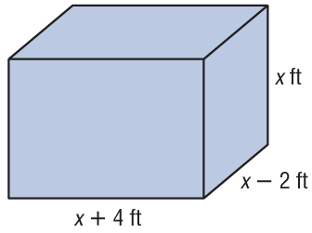
Example 2
Find Rational Zeros
GEOMETRY The volume of a rectangular solid is 1120 cubic feet. The width is 2 feet less than the height, and the length is 4 feet more than the height. Find the dimensions of the solid.
Let x = the height, x – 2 = the width, and x + 4 = the length.

Slide 9
Example 2
Find Rational Zeros
Write the equation for volume.
ℓ ● w ● h = V Formula for volume
Substitute.
Multiply.
Subtract 1120 from each side.
The leading coefficient is 1, so the possible integer zeros are factors of 1120. Since length can only be positive, we only need to check positive zeros.

Slide 10
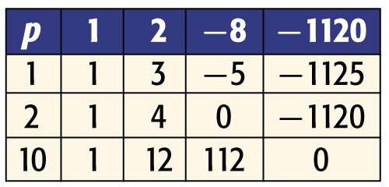
Example 2
Find Rational Zeros
The possible factors are 1, 2, 4, 5, 7, 8, 10, 14, 16, 20, 28, 32, 35, 40, 56, 70, 80, 112, 140, 160, 224, 280, 560, and 1120. By Descartes’ Rule of Signs, we know that there is exactly one positive real root. Make a table and test possible real zeros.
So, the zero is 10. The other dimensions are 10 – 2 or 8 feet and 10 + 4 or 14 feet.

Slide 11
Example 2
Find Rational Zeros
Answer: ℓ = 14 ft, w = 8 ft, and h = 10 ft
Check Verify that the dimensions are correct.
10 × 8 × 14 = 1120 ✓

Slide 12
Example 3
Find All Zeros
Find all of the zeros of f(x) = x⁴ + x³ – 19x² + 11x + 30.
From the corollary to the Fundamental Theorem of Algebra, we know there are exactly 4 complex roots.
According to Descartes’ Rule of Signs, there are 2 or 0 positive real roots and 2 or 0 negative real roots.
The possible rational zeros are ±1, ±2, ±3, ±5, ±6, ±10, ±15, and ±30.
Make a table and test some possible rational zeros.

Slide 13
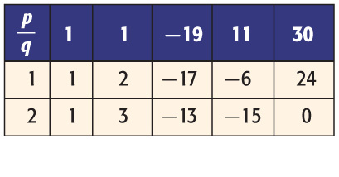
Example 3
Find All Zeros
Since f(2) = 0, you know that x = 2 is a zero. The depressed polynomial is x³ + 3x² – 13x – 15.

Slide 14
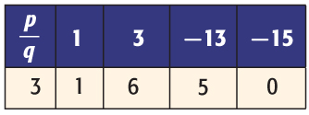
Example 3
Find All Zeros
Since x = 2 is a positive real zero, and there can only be 2 or 0 positive real zeros, there must be one more positive real zero. Test the next possible rational zeros on the depressed polynomial.
There is another zero at x = 3. The depressed polynomial is x² + 6x + 5.

Slide 15
Example 3
Find All Zeros
Factor x² + 6x + 5.
Write the depressed polynomial.
Factor.
or
Zero Product Property
There are two more real roots at x = –5 and x = –1.
Answer: The zeros of this function are –5, –1, 2, and 3.

Slide 16
Example 3
Find all of the zeros of f(x) = x⁴ + 4x³ – 14x² – 36x + 45.
A. –10, –3, 1, and 3
B. –5, 1, and 3
C. –5 and –3
D. –5, –3, 1 and 3
A
B
C
D

Slide 17
End of the Lesson

