Slide 1
Splash Screen

Slide 2
Then/Now
You graphed exponential functions. (Lesson 8–1)
Solve exponential equations.
Solve exponential inequalities.

Slide 3
Vocabulary
exponential equation
compound interest
exponential inequality

Slide 4
Concept

Slide 5
Example 1A
Solve Exponential Equations
A. Solve the equation 3^{x} = 9⁴.
3^{x} = 9⁴ Original equation
3^{x} = (3²)⁴ Rewrite 9 as 3².
3^{x} = 3⁸ Power of a Power
x = 8 Property of Equality for Exponential Functions
Answer: x = 8

Slide 6
Example 1B
Solve Exponential Equations
B. Solve the equation 2^{5x} = 4^{2x – 1}.
2^{5x} = 4^{2x – 1} Original equation
2^{5x} = (2²)^{2x – 1} Rewrite 4 as 2².
2^{5x} = 2^{4x – 2} Power of a Power
5x = 4x – 2 Property of Equality for Exponential Functions
x = –2 Subtract 4x from each side.
Answer: x = –2

Slide 7
Example 1A
A. Solve the equation 4^{x} = 64³.
A. 3
B. 9
C. 18
D. 27
A
B
C
D

Slide 8
Example 1B
B. Solve the equation 3^{2x} = 9^{5x – 4}.
A. 1
B. 2
C. 4
D. 5
A
B
C
D

Slide 9
Example 2A
Write an Exponential Function
A. POPULATION In 2000, the population of Phoenix was 1,321,045. By 2007, it was estimated at 1,512,986. Write an exponential function that could be used to model the population of Phoenix. Write x in terms of the numbers of years since 2000.
At the beginning of the timeline in 2000, x is 0 and the population is 1,321,045. Thus, the y-intercept, and the value of a, is 1,321,045.
When x = 7, the population is 1,512,986. Substitute these values into an exponential function to determine the value of b.

Slide 10
Example 2A
Write an Exponential Function
y = ab ^{x} Exponential function
1,512,986 = 1,321,045 ● b⁷ Replace x with 7, y with 1,512,986, and a with 1,321,045.
1.145 ≈ b⁷ Divide each side by 1,321,045.
Take the 7th root of each side.
1.0196 ≈ b Use a calculator.
Answer: An equation that models the number of years is y = 1,321,045(1.0196)^{x}.

Slide 11
Example 2B
Write an Exponential Function
B. POPULATION In 2000, the population of Phoenix was 1,321,045. By 2007, it was estimated at 1,512,986. Predict the population of Phoenix in 2013.
y = 1,321,045(1.0196)^{x} Modeling equation
y = 1,321,045(1.0196)¹³ Replace x with 13.
y ≈ 1,700,221 Use a calculator.
Answer: The population will be about 1,700,221.

Slide 12
Example 2A
A. POPULATION In 2000, the population of the town of Tisdale was 9,426. By 2007, it was estimated at 17,942. Write an exponential function that could be used to model the population of Tisdale. Write x in terms of the numbers of years since 2000.
A. y = 9,426(1.0963)^{x – 7}
B. y = 1.0963(9,426)^{x}
C. y = 9,426(x)^{1.0963}
D. y = 9,426(1.0963)^{x}
A
B
C
D

Slide 13
Example 2B
B. POPULATION In 2000, the population of the town of Tisdale was 9,426. By 2007, it was estimated at 17,942. Predict the population of Tisdale in 2012.
A. 28,411
B. 30,462
C. 32,534
D. 34,833
A
B
C
D

Slide 14
Concept

Slide 15
Example 3
Compound Interest
An investment account pays 5.4% annual interest compounded quarterly. If $4000 is placed in this account, find the balance after 8 years.
Understand
Find the balance of the account after 8 years.
Plan
Use the compound interest formula.
P = 4000, r = 0.054, n = 4, and t = 8

Slide 16
Example 3
Compound Interest
Solve
Compound Interest Formula
P = 4000, r = 0.054, n = 4, and t = 8
Use a calculator.
Answer: The balance in the account after 8 years will be $6143.56.

Slide 17
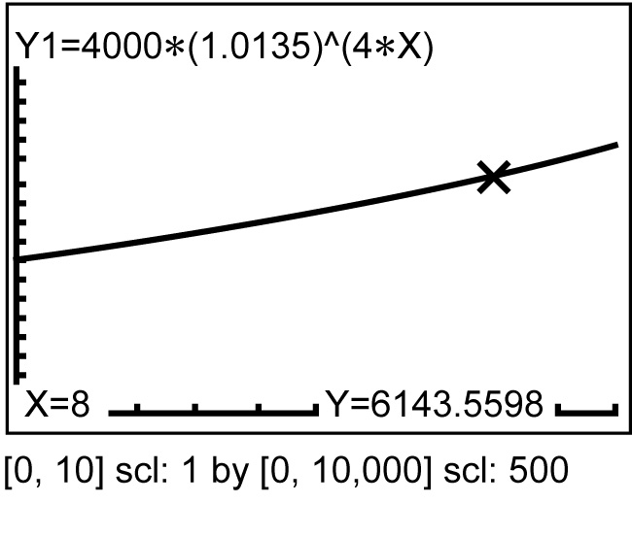
Example 3
Compound Interest
Check
Graph the corresponding equation y = 4000(1.0135)^{4t}. Use the CALC: value to find y when x = 8.
The y-value 6143.6 is very close to 6143.56, so the answer is reasonable.

Slide 18
Example 3
An investment account pays 4.6% annual interest compounded quarterly. If $6050 is placed in this account, find the balance after 6 years.
A. $6810.53
B. $7420.65
C. $7960.43
D. $8134.22
A
B
C
D

Slide 19
Concept

Slide 20
Example 4
Solve Exponential Inequalities
Original equation
Property of Inequality for Exponential Functions
Subtract 3 from each side.

Slide 21
Example 4
Solve Exponential Inequalities
Divide each side by –2 and reverse the inequality symbol.
Answer:

Slide 22
Example 4
A. x < 9
B. x > 3
C. x < 3
D. x > 6
A
B
C
D

Slide 23
End of the Lesson

