Slide 1
Splash Screen

Slide 2
Then/Now
You used basic geometric concepts and properties to solve problems.
Identify and model points, lines, and planes.
Identify intersecting lines and planes.

Slide 3
Vocabulary
definition
defined term
space
undefined term
point
line
plane
collinear
coplanar
intersection

Slide 4
Concept

Slide 5
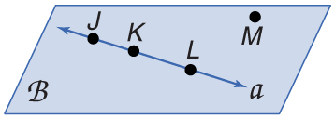
Example 1
Name Lines and Planes
A. Use the figure to name a line containing point K.
Answer: The line can be named as line a.
There are three points on the line. Any two of the points can be used to name the line.

Slide 6
Example 1
Name Lines and Planes
B. Use the figure to name a plane containing point L.
Answer: The plane can be named as plane B.
You can also use the letters of any three noncollinear points to name the plane. plane JKM plane KLM plane JLM

Slide 7
Example 1
Name Lines and Planes
The letters of each of these names can be reordered to create other acceptable names for this plane. For example, JKM can also be written as JMK, MKJ, KJM, KMJ, and MJK. There are 15 different three-letter names for this plane.

Slide 8
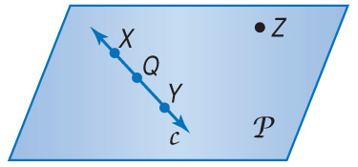
Example 1a
A. Use the figure to name a line containing the point X.
A. line X
B. line c
C. line Z
D.
A
B
C
D

Slide 9
Example 1b
B. Use the figure to name a plane containing point Z.
A. plane XY
B. plane c
C. plane XQY
D. plane P
A
B
C
D

Slide 10
Example 2
Model Points, Lines, and Planes
A. Name the geometric shape modeled by a 10 × 12 patio.
Answer: The patio models a plane.

Slide 11
Example 2
Model Points, Lines, and Planes
B. Name the geometric shape modeled by a button on a table.
Answer: The button on the table models a point on a plane.

Slide 12
Example 2a
A. Name the geometric shape modeled by a colored dot on a map used to mark the location of a city.
A. point
B. line segment
C. plane
D. none of the above
A
B
C
D

Slide 13
Example 2b
B. Name the geometric shape modeled by the ceiling of your classroom.
A. point
B. line segment
C. plane
D. none of the above
A
B
C
D

Slide 14
Example 3
Draw Geometric Figures
Draw a surface to represent plane R and label it.

Slide 15
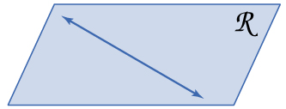
Example 3
Draw Geometric Figures
Draw a line anywhere on the plane.

Slide 16
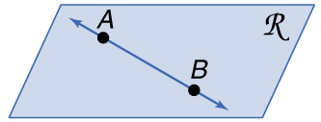
Example 3
Draw Geometric Figures
Draw dots on the line for point A and B. Label the points.

Slide 17
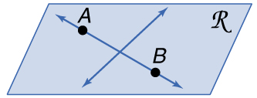
Example 3
Draw Geometric Figures

Slide 18
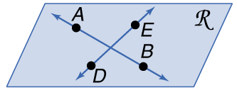
Example 3
Draw Geometric Figures
Draw dots on this line for point D and E. Label the points.

Slide 19
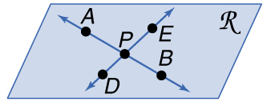
Example 3
Draw Geometric Figures
Label the intersection point of the two lines as P.

Slide 20
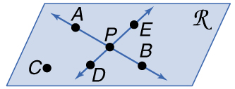
Example 3
Draw Geometric Figures
Answer:

Slide 21
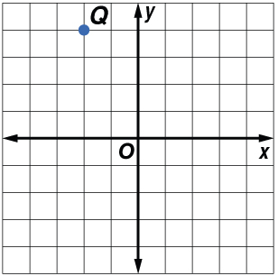
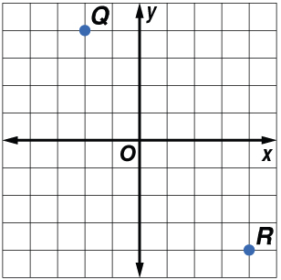
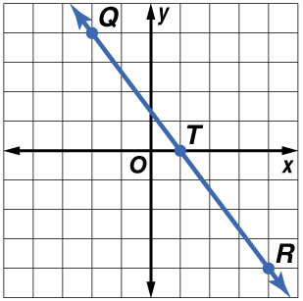
Example 3
Draw Geometric Figures
Answer:
There are an infinite number of points that are collinear with Q and R. In the graph, one such point is T(1, 0).

Slide 22
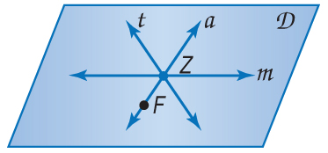
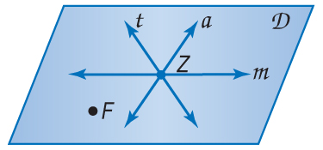
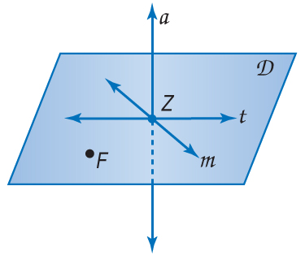
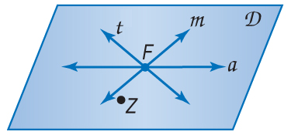
Example 3a
A. Choose the best diagram for the given relationship. Plane D contains line a, line m, and line t, with all three lines intersecting at point Z. Also, point F is on plane D and is not collinear with any of the three given lines.
A. B. C. D.
A
B
C
D

Slide 23
Example 3b

Slide 24
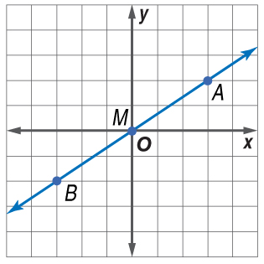
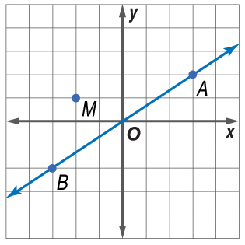
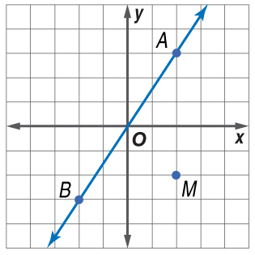
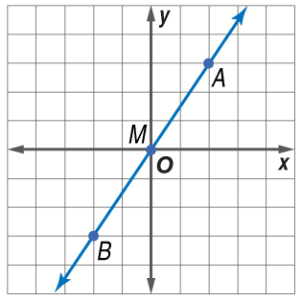
Example 3b
A. B.
C. D.
A
B
C
D

Slide 25
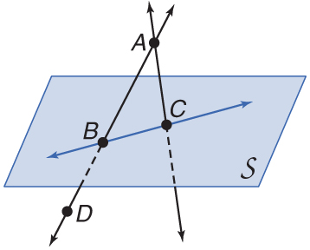
Example 4
Interpret Drawings
A. How many planes appear in this figure?
Answer: There are two planes: plane S and plane ABC.

Slide 26
Example 4
Interpret Drawings
B. Name three points that are collinear.
Answer: Points A, B, and D are collinear.

Slide 27
Example 4
Interpret Drawings
C. Are points A, B, C, and D coplanar? Explain.
Answer: Points A, B, C, and D all lie in plane ABC, so they are coplanar.

Slide 28
Example 4
Interpret Drawings
Answer: The two lines intersect at point A.

Slide 29
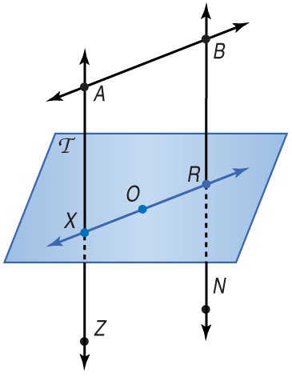
Example 4a
A. How many planes appear in this figure?
A. one
B. two
C. three
D. four
A
B
C
D

Slide 30
Example 4b
B. Name three points that are collinear.
A. B, O, and X
B. X, O, and N
C. R, O, and B
D. A, X, and Z
A
B
C
D

Slide 31
Example 4c
C. Are points X, O, and R coplanar?
A. yes
B. no
C. cannot be determined
A
B
C

Slide 32
Example 4d
A. point X
B. point N
C. point R
D. point A
A
B
C
D

Slide 33
End of the Lesson

