Slide 1
Splash Screen

Slide 2
Then/Now
You used deductive reasoning by applying the Law of Detachment and the Law of Syllogism. (Lesson 2–4)
Identify and use basic postulates about points, lines, and planes.
Write paragraph proofs.

Slide 3
Vocabulary
postulate
axiom
proof
theorem
deductive argument
paragraph proof
informal proof

Slide 4
Concept

Slide 5
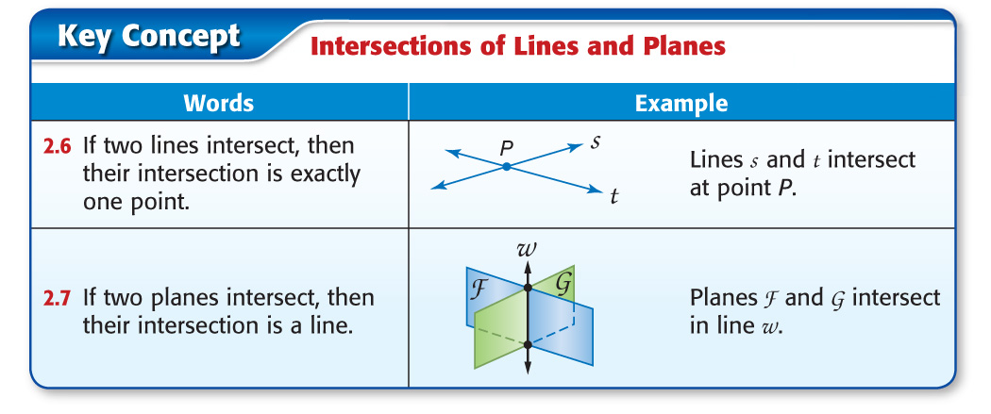
Concept

Slide 6
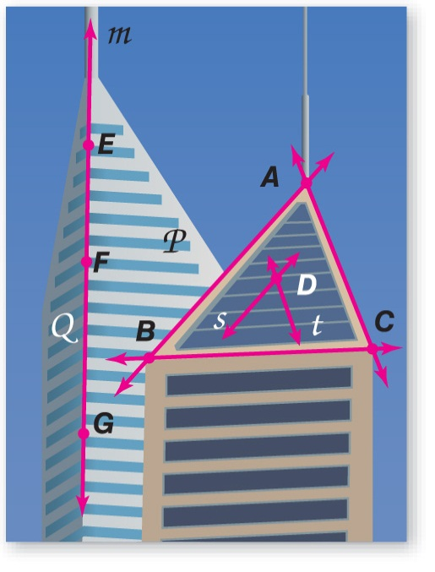
Example 1
Identifying Postulates
ARCHITECTURE Explain how the picture illustrates that the statement is true. Then state the postulate that can be used to show the statement is true.
A. Points F and G lie in plane Q and on line m. Line m lies entirely in plane Q.
Answer: Points F and G lie on line m, and the line lies in plane Q. Postulate 2.5, which states that if two points lie in a plane, the entire line containing the points lies in that plane, shows that this is true.

Slide 7
Example 1
Identifying Postulates
ARCHITECTURE Explain how the picture illustrates that the statement is true. Then state the postulate that can be used to show the statement is true.
B. Points A and C determine a line.
Answer: Points A and C lie along an edge, the line that they determine. Postulate 2.1, which says through any two points there is exactly one line, shows that this is true.

Slide 8
Example 1
ARCHITECTURE Refer to the picture. State the postulate that can be used to show the statement is true. A. Plane P contains points E, B, and G.
A. Through any two points there is exactly one line.
B. A line contains at least two points.
C. A plane contains at least three noncollinear points.
D. A plane contains at least two noncollinear points.
A
B
C
D

Slide 9
Example 1
ARCHITECTURE Refer to the picture. State the postulate that can be used to show the statement is true. B. Line AB and line BC intersect at point B.
A. Through any two points there is exactly one line.
B. A line contains at least two points.
C. If two lines intersect, then their intersection is exactly one point.
D. If two planes intersect, then their intersection is a line.
A
B
C
D

Slide 10
Example 2
Analyze Statements Using Postulates
A. Determine whether the following statement is always, sometimes, or never true. Explain.
If plane T contains contains point G, then plane T contains point G.
Answer: Always; Postulate 2.5 states that if two points lie in a plane, then the entire line containing those points lies in the plane.

Slide 11
Example 2
Analyze Statements Using Postulates
B. Determine whether the following statement is always, sometimes, or never true. Explain.
contains three noncollinear points.
Answer: Never; noncollinear points do not lie on the same line by definition.

Slide 12
Example 2
A. Determine whether the statement is always, sometimes, or never true. Plane A and plane B intersect in exactly one point.
A. always
B. sometimes
C. never
A
B
C

Slide 13
Example 2
B. Determine whether the statement is always, sometimes, or never true. Point N lies in plane X and point R lies in plane Z. You can draw only one line that contains both points N and R.
A
B
C
A. always
B. sometimes
C. never

Slide 14
Concept

Slide 15
Example 3
Write a Paragraph Proof
Given:
Prove: ACD is a plane.
Proof: and must intersect at C because if two lines intersect, then their intersection is exactly one point. Point A is on and point D is on . Points A, C, and D are not collinear. Therefore, ACD is a plane as it contains three points not on the same line.

Slide 16
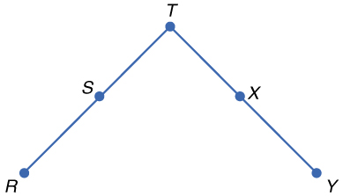
Example 3

Slide 17
Example 3
Proof:
?

Slide 18
Example 3
A. Definition of midpoint
B. Segment Addition Postulate
C. Definition of congruent segments
D. Substitution
A
B
C
D

Slide 19
Concept

Slide 20
End of the Lesson

