Slide 1
Splash Screen

Slide 2
Lesson Menu
Five-Minute Check (over Lesson 2–5)
Then/Now
New Vocabulary
Key Concept: Properties of Real Numbers
Example 1: Justify Each Step When Solving an Equation
Example 2: Real-World Example: Write an Algebraic Proof
Example 3: Write a Geometric Proof

Slide 3
Then/Now
You used postulates about points, lines, and planes to write paragraph proofs. (Lesson 2–5)
Use algebra to write two-column proofs.
Use properties of equality to write geometric proofs.

Slide 4
Vocabulary
algebraic proof
two-column proof
formal proof

Slide 5
Concept

Slide 6
Example 1
Justify Each Step When Solving an Equation
Solve 2(5 – 3a) – 4(a + 7) = 92.
Algebraic Steps Properties
2(5 – 3a) – 4(a + 7) = 92 Original equation
10 – 6a – 4a – 28 = 92 Distributive Property
–18 – 10a = 92 Substitution Property
–18 – 10a + 18 = 92 + 18 Addition Property

Slide 7
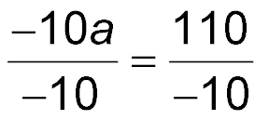
Example 1
Justify Each Step When Solving an Equation
–10a = 110 Substitution Property
Division Property
a = –11 Substitution Property
Answer: a = –11

Slide 8
Example 2
Write an Algebraic Proof
Begin by stating what is given and what you are to prove.

Slide 9
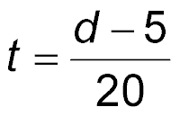
Example 2
Write an Algebraic Proof
Proof:
Statements Reasons
1.
d = 20t + 5
1. Given
2. d – 5 = 20t
2. Addition Property of Equality
3.
= t
3. Division Property of Equality
4.
4. Symmetric Property of Equality

Slide 10
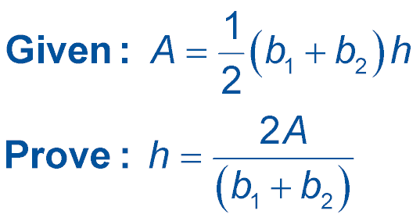
Example 2
Which of the following statements would complete the proof of this conjecture?
If the formula for the area of a trapezoid is , then the height h of the trapezoid is given by .

Slide 11
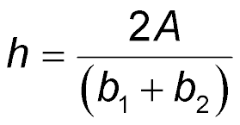
Example 2
Proof:
Statements Reasons
1.
1. Given
?
2. _____________
2. Multiplication Property of Equality
3.
3. Division Property of Equality
4.
4. Symmetric Property of Equality

Slide 12
Example 3
Write a Geometric Proof
If ∠A ∠B, m∠B = 2m∠C, and m∠C = 45, then m∠A = 90. Write a two-column proof to verify this conjecture.

Slide 13
Example 3
Write a Geometric Proof
Proof:
Statements Reasons
1.
∠A ∠B; m∠B = 2m∠C; m∠C = 45
1. Given
2. m∠A = m∠B
2. Definition of angles
3. m∠A = 2m∠C
3. Transitive Property of Equality
4.
m∠A = 2(45)
4. Substitution
5. m∠A = 90
5. Substitution

Slide 14
End of the Lesson

