Slide 1
Splash Screen

Slide 2
Then/Now
You wrote algebraic and two-column proofs. (Lesson 2–6)
Write proofs involving segment addition.
Write proofs involving segment congruence.

Slide 3
Concept

Slide 4
Concept

Slide 5
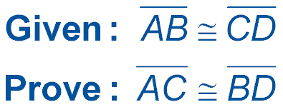
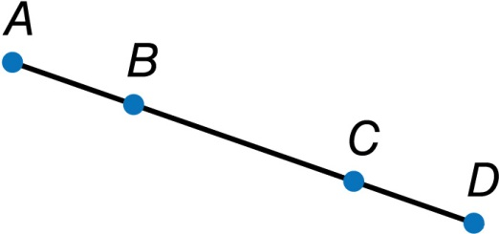
Example 1
Use the Segment Addition Postulate
Proof:
Statements Reasons
___
___
1.
AB ≅ CD
1. Given
2.
AB = CD
2. Definition of congruent segments
3.
BC = BC
3. Reflexive Property of Equality
4.
AB + BC = AC
4. Segment Addition Postulate

Slide 6
Example 1
Use the Segment Addition Postulate
Proof:
Statements Reasons
5. CD + BC = AC
5. Substitution Property of Equality
6.
CD + BC = BD
6. Segment Addition Postulate
7.
AC = BD
7. Transitive Property of Equality
___
___
8.
AC ≅ BD
8. Definition of congruent segments

Slide 7
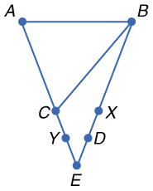
Example 1
Prove the following.
Given: AC = AB AB = BX CY = XD
Prove: AY = BD

Slide 8
Example 1
Which reason correctly completes the proof?
Proof:
Statements Reasons
1.
AC = AB, AB = BX
1. Given
2.
AC = BX
2. Transitive Property
3.
CY = XD
3. Given
4.
AC + CY = BX + XD
4. Addition Property
5.
5. ________________
AC + CY = AY; BX + XD = BD
?
6.
AY = BD
6. Substitution

Slide 9
Example 1
A. Addition Property
B. Substitution
C. Definition of congruent segments
D. Segment Addition Postulate
A
B
C
D

Slide 10
Concept

Slide 11
Concept

Slide 12
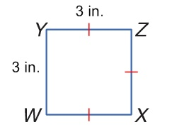
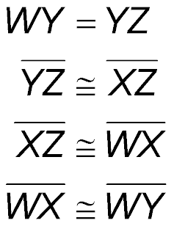
Example 2
Proof Using Segment Congruence
BADGE Jamie is designing a badge for her club. The length of the top edge of the badge is equal to the length of the left edge of the badge. The top edge of the badge is congruent to the right edge of the badge, and the right edge of the badge is congruent to the bottom edge of the badge. Prove that the bottom edge of the badge is congruent to the left edge of the badge.
Given:
Prove:

Slide 13
Example 2
Proof Using Segment Congruence
Proof:
Statements Reasons
1.
1. Given
2.
2. Definition of congruent segments
3.
3. Given
___
4.
YZ
4. Transitive Property
5.
5. Substitution

Slide 14
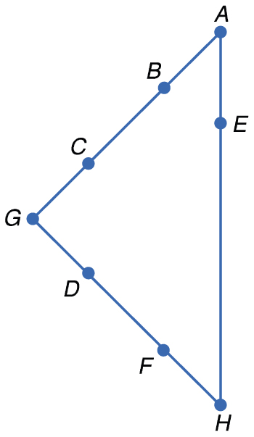
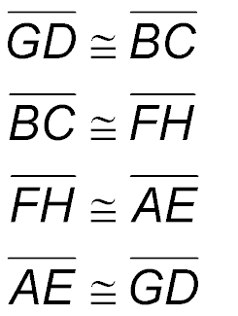
Example 2
Prove the following.
Given:
Prove:

Slide 15
Example 2
Which choice correctly completes the proof?
Proof:
Statements Reasons
1.
1. Given
2.
2. Transitive Property
3.
3. Given
4.
4. Transitive Property
?
5.
5. _______________

Slide 16
Example 2
A. Substitution
B. Symmetric Property
C. Segment Addition Postulate
D. Reflexive Property
A
B
C
D

Slide 17
End of the Lesson

