Slide 1
Splash Screen

Slide 2
Then/Now
You found slopes of lines and used them to identify parallel and perpendicular lines. (Lesson 3–3)
Recognize angle pairs that occur with parallel lines.
Prove that two lines are parallel using angle relationships.

Slide 3
Concept

Slide 4
Concept

Slide 5
Concept

Slide 6
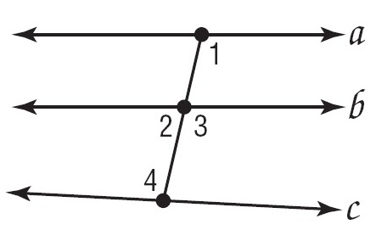
Example 1
Identify Parallel Lines
A. Given ∠1 ≅ ∠3, is it possible to prove that any of the lines shown are parallel? If so, state the postulate or theorem that justifies your answer.
∠1 and ∠3 are corresponding angles of lines a and b.
Answer: Since ∠1 ≅ ∠3, a║b by the Converse of the Corresponding Angles Postulate.

Slide 7
Example 1
Identify Parallel Lines
B. Given m∠1 = 103 and m∠4 = 100, is it possible to prove that any of the lines shown are parallel? If so, state the postulate or theorem that justifies your answer.
∠1 and ∠4 are alternate interior angles of lines a and c.
Answer: Since ∠1 is not congruent to ∠4, line a is not parallel to line c by the Converse of the Alternate Interior Angles Theorem.

Slide 8
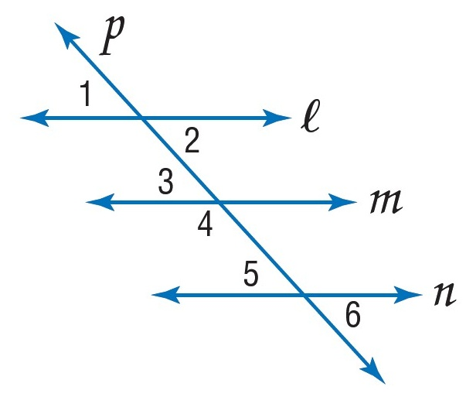
Example 1
A. Given ∠1 ≅ ∠5, is it possible to prove that any of the lines shown are parallel?
A. Yes; ℓ ║ n
B. Yes; m ║ n
C. Yes; ℓ ║ m
D. It is not possible to prove any of the lines parallel.
A
B
C
D

Slide 9
Example 1
B. Given m∠4 = 105 and m∠5 = 70, is it possible to prove that any of the lines shown are parallel?
A. Yes; ℓ ║ n
B. Yes; m ║ n
C. Yes; ℓ ║ m
D. It is not possible to prove any of the lines parallel.
A
B
C
D

Slide 10
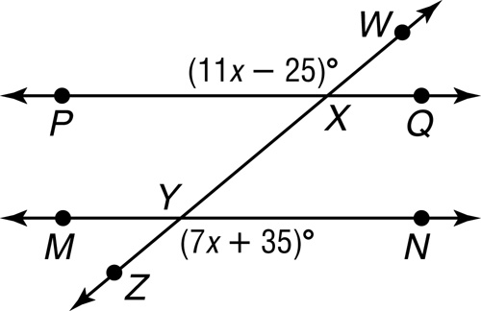
Example 2
Find m∠ZYN so that || . Show your work.
Read the Test Item From the figure, you know that m∠WXP = 11x – 25 and m∠ZYN = 7x + 35. You are asked to find m∠ZYN.

Slide 11
Example 2
Solve the Test Item ∠WXP and ∠ZYN are alternate exterior angles. For line PQ to be parallel to line MN, the alternate exterior angles must be congruent. So m∠WXP = m∠ZYN. Substitute the given angle measures into this equation and solve for x. Once you know the value of x, use substitution to find m∠ZYN.
m WXP = m ZYN Alternate exterior angles
11x – 25 = 7x + 35 Substitution
4x – 25 = 35 Subtract 7x from each side.
4x = 60 Add 25 to each side.
x = 15 Divide each side by 4.

Slide 12
Example 2
Now use the value of x to find m∠ZYN.
m∠ZYN = 7x + 35 Original equation
= 7(15) + 35 x = 15
= 140 Simplify.
Answer: m∠ZYN = 140
Check Verify the angle measure by using the value of x to find m∠WXP.
m∠WXP = 11x – 25
= 11(15) – 25
= 140
Since m∠WXP = m∠ZYN, ∠WXP ≅ ∠ZYN and || .

Slide 13
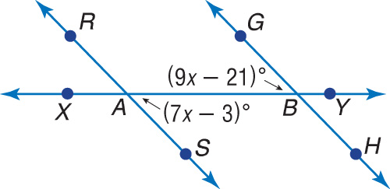
Example 2
ALGEBRA Find x so that || .
A. x = 60
B. x = 9
C. x = 12
D. x = 12
A
B
C
D

Slide 14
End of the Lesson

