Slide 1
Splash Screen

Slide 2
Then/Now
You used properties of special parallelograms. (Lesson 6–5)
Apply properties of trapezoids.
Apply properties of kites.

Slide 3
Vocabulary
trapezoid
bases
legs of a trapezoid
base angles
isosceles trapezoid
midsegment of a trapezoid
kite

Slide 4
Concept 1

Slide 5
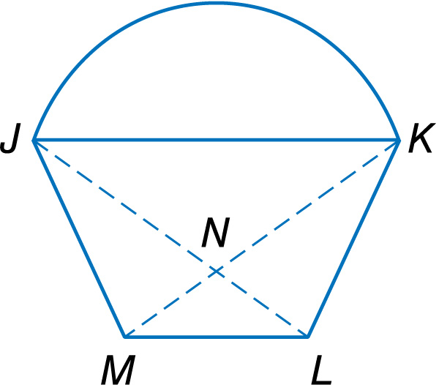
Example 1A
Use Properties of Isosceles Trapezoids
A. BASKET Each side of the basket shown is an isosceles trapezoid. If m∠JML = 130, KN = 6.7 feet, and LN = 3.6 feet, find m∠MJK.

Slide 6
Example 1A
Use Properties of Isosceles Trapezoids
Since JKLM is a trapezoid, JK║LM.
m∠JML + m∠MJK = 180 Consecutive Interior Angles Theorem
130 + m∠MJK = 180 Substitution
m∠MJK = 50 Subtract 130 from each side.
Answer: m∠MJK = 50

Slide 7
Example 1B
Use Properties of Isosceles Trapezoids
B. BASKET Each side of the basket shown is an isosceles trapezoid. If m∠JML = 130, KN = 6.7 feet, and JL is 10.3 feet, find MN.

Slide 8
Example 1B
Use Properties of Isosceles Trapezoids
Since JKLM is an isosceles trapezoid, diagonals JL and KM are congruent.
JL = KM Definition of congruent
JL = KN + MN Segment Addition
10.3 = 6.7 + MN Substitution
3.6 = MN Subtract 6.7 from each side.
Answer: MN = 3.6

Slide 9
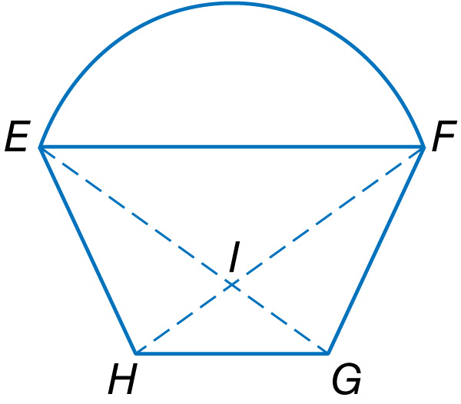
Example 1A
A. Each side of the basket shown is an isosceles trapezoid. If m∠FGH = 124, FI = 9.8 feet, and IG = 4.3 feet, find m∠EFG.
A. 124
B. 62
C. 56
D. 112
A
B
C
D

Slide 10
Example 1B
B. Each side of the basket shown is an isosceles trapezoid. If m∠FGH = 124, FI = 9.8 feet, and EG = 14.1 feet, find IH.
A. 4.3 ft
B. 8.6 ft
C. 9.8 ft
D. 14.1 ft
A
B
C
D

Slide 11
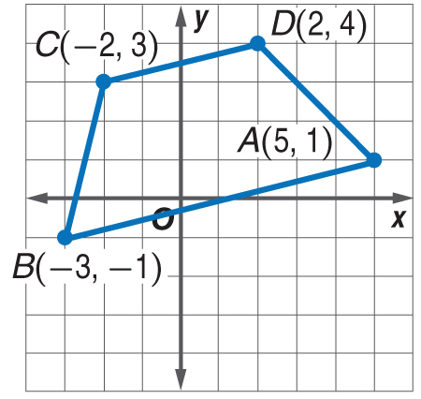
Example 2
Isosceles Trapezoids and Coordinate Geometry
Quadrilateral ABCD has vertices A(5, 1), B(–3, –1), C(–2, 3), and D(2, 4). Show that ABCD is a trapezoid and determine whether it is an isosceles trapezoid.
A quadrilateral is a trapezoid if exactly one pair of opposite sides are parallel. Use the Slope Formula.

Slide 12
Example 2
Isosceles Trapezoids and Coordinate Geometry
slope of
slope of
slope of
Answer: Exactly one pair of opposite sides are parallel, So, ABCD is a trapezoid.

Slide 13
Example 2
Isosceles Trapezoids and Coordinate Geometry
Use the Distance Formula to show that the legs are congruent.
Answer: Since the legs are not congruent, ABCD is not an isosceles trapezoid.

Slide 14
Example 2
Quadrilateral QRST has vertices Q(–1, 0), R(2, 2), S(5, 0), and T(–1, –4). Determine whether QRST is a trapezoid and if so, determine whether it is an isosceles trapezoid.
A. trapezoid; not isosceles
B. trapezoid; isosceles
C. not a trapezoid
D. cannot be determined
A
B
C
D

Slide 15
Concept 3

Slide 16
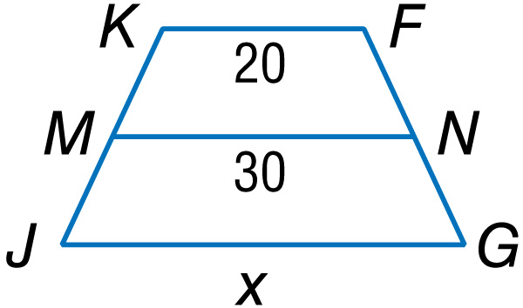
Example 3
In the figure, MN is the midsegment of trapezoid FGJK. What is the value of x?

Slide 17
Example 3
Read the Test Item
You are given the measure of the midsegment of a trapezoid and the measures of one of its bases. You are asked to find the measure of the other base.
Solve the Test Item
Trapezoid Midsegment Theorem
Substitution

Slide 18
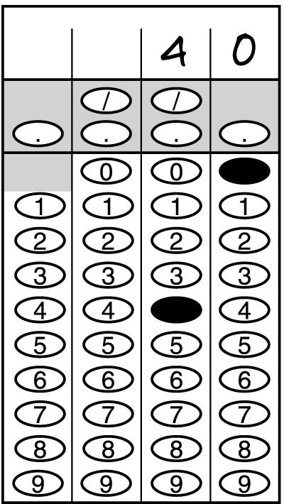
Example 3
Multiply each side by 2.
Subtract 20 from each side.
Answer: x = 40

Slide 19
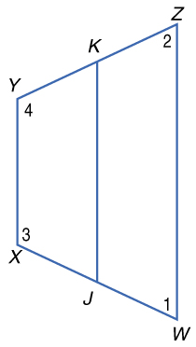
Example 3
WXYZ is an isosceles trapezoid with median Find XY if JK = 18 and WZ = 25.
A. XY = 32
B. XY = 25
C. XY = 21.5
D. XY = 11
A
B
C
D

Slide 20
Concept 4

Slide 21
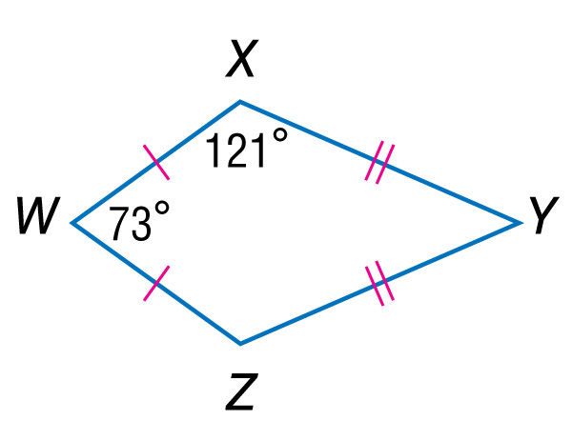
Example 4A
Use Properties of Kites
A. If WXYZ is a kite, find m∠XYZ.

Slide 22
Example 4A
Use Properties of Kites
Since a kite only has one pair of congruent angles, which are between the two non-congruent sides, ∠WXY ≅ ∠WZY. So, ∠WZY = 121°.
m∠W + m∠X + m∠Y + m∠Z = 360 Polygon Interior Angles Sum Theorem
73 + 121 + m∠Y + 121 = 360 Substitution
m∠Y = 45 Simplify.
Answer: m∠XYZ = 45

Slide 23
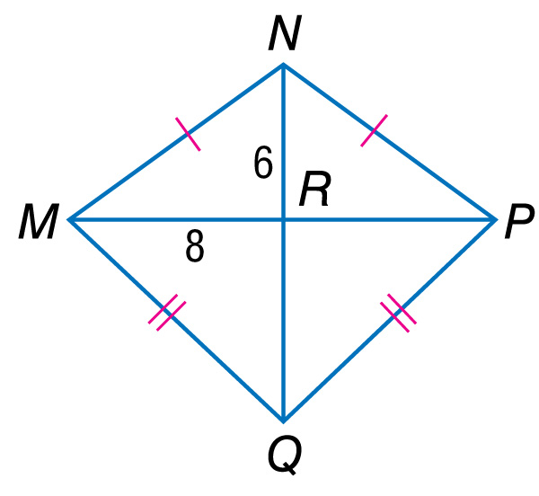
Example 4B
Use Properties of Kites
B. If MNPQ is a kite, find NP.

Slide 24
Example 4B
Use Properties of Kites
Since the diagonals of a kite are perpendicular, they divide MNPQ into four right triangles. Use the Pythagorean Theorem to find MN, the length of the hypotenuse of right ΔMNR.
NR² + MR² = MN² Pythagorean Theorem
(6)² + (8)² = MN² Substitution
36 + 64 = MN² Simplify.
100 = MN² Add.
10 = MN Take the square root of each side.

Slide 25
Example 4B
Use Properties of Kites
Since MN ≅ NP, MN = NP. By substitution, NP = 10.
Answer: NP = 10

Slide 26
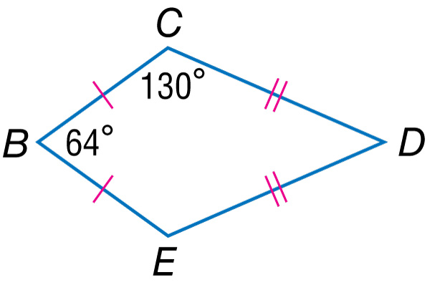
Example 4A
A. If BCDE is a kite, find m∠CDE.
A. 28°
B. 36°
C. 42°
D. 55°
A
B
C
D

Slide 27
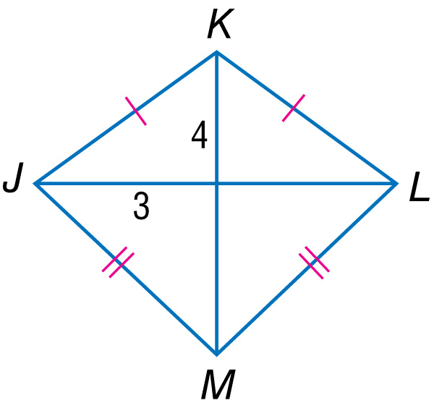
Example 4B
B. If JKLM is a kite, find KL.
A. 5
B. 6
C. 7
D. 8
A
B
C
D

Slide 28
End of the Lesson

