Slide 1
Splash Screen

Slide 2
Then/Now
You used the AAS, SSS, and SAS Congruence Theorems to prove triangles congruent. (Lesson 4–4)
Identify similar triangles using the AA Similarity Postulate and the SSS and SAS Similarity Theorems.
Use similar triangles to solve problems.

Slide 3
Concept

Slide 4
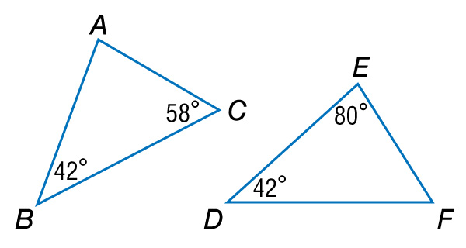
Example 1
Use the AA Similarity Postulate
A. Determine whether the triangles are similar. If so, write a similarity statement. Explain your reasoning.

Slide 5
Example 1
Use the AA Similarity Postulate
Since m∠B = m∠D, ∠B ∠D.
By the Triangle Sum Theorem, 42 + 58 + m∠A = 180, so m∠A = 80.
Since m∠E = 80, ∠A ∠E.
Answer: So, ΔABC ~ ΔEDF by the AA Similarity.

Slide 6
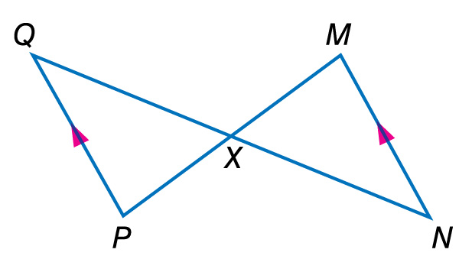
Example 1
Use the AA Similarity Postulate
B. Determine whether the triangles are similar. If so, write a similarity statement. Explain your reasoning.

Slide 7
Example 1
Use the AA Similarity Postulate
∠QXP ∠NXM by the Vertical Angles Theorem.
Since QP || MN, ∠Q ∠N.
Answer: So, ΔQXP ~ ΔNXM by AA Similarity.

Slide 8
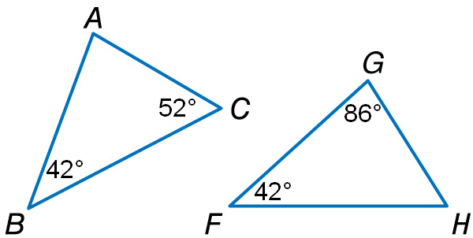
Example 1
A. Determine whether the triangles are similar. If so, write a similarity statement.
A. Yes; ΔABC ~ ΔFGH
B. Yes; ΔABC ~ ΔGFH
C. Yes; ΔABC ~ ΔHFG
D. No; the triangles are not similar.
A
B
C
D

Slide 9
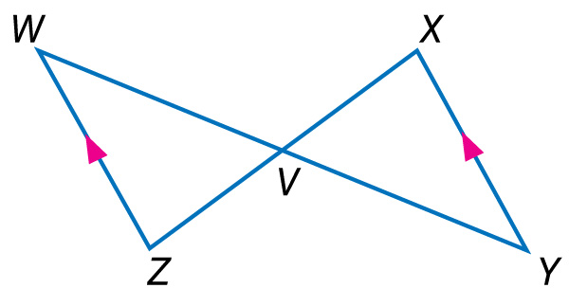
Example 1
B. Determine whether the triangles are similar. If so, write a similarity statement.
A. Yes; ΔWVZ ~ ΔYVX
B. Yes; ΔWVZ ~ ΔXVY
C. Yes; ΔWVZ ~ ΔXYV
D. No; the triangles are not similar.
A
B
C
D

Slide 10
Concept

Slide 11
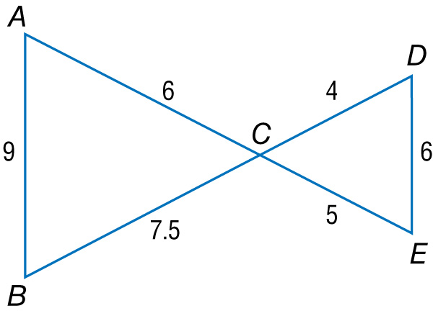
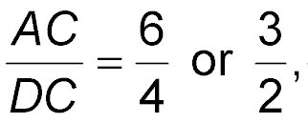
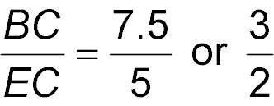
Example 2
Use the SSS and SAS Similarity Theorems
A. Determine whether the triangles are similar. If so, write a similarity statement. Explain your reasoning.
Answer: So, ΔABC ~ ΔDEC by the SSS Similarity Theorem.

Slide 12
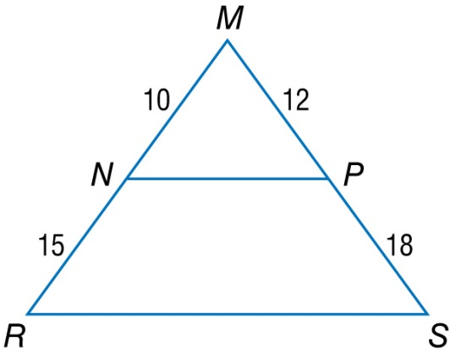
Example 2
Use the SSS and SAS Similarity Theorems
B. Determine whether the triangles are similar. If so, write a similarity statement. Explain your reasoning.
By the Reflexive Property, ∠M ≅ ∠M.
Answer: Since the lengths of the sides that include ∠M are proportional, ΔMNP ~ ΔMRS by the SAS Similarity Theorem.

Slide 13
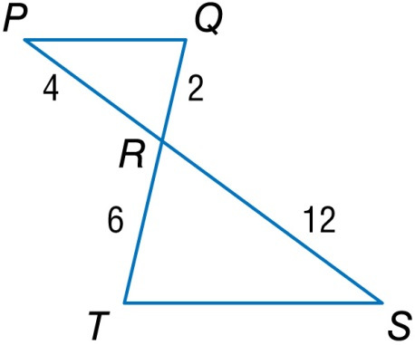
Example 2
A. Determine whether the triangles are similar. If so, choose the correct similarity statement to match the given data.
A. ΔPQR ~ ΔSTR by SSS Similarity Theorem
B. ΔPQR ~ ΔSTR by SAS Similarity Theorem
C. ΔPQR ~ ΔSTR by AA Similarity Theorem
D. The triangles are not similar.
A
B
C
D

Slide 14
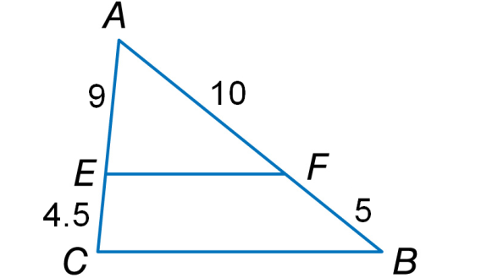
Example 2
B. Determine whether the triangles are similar. If so, choose the correct similarity statement to match the given data.
A. ΔAFE ~ ΔABC by SAS Similarity Theorem
B. ΔAFE ~ ΔABC by SSS Similarity Theorem
C. ΔAFE ~ ΔACB by SAS Similarity Theorem
D. ΔAFE ~ ΔACB by SSS Similarity Theorem
A
B
C
D

Slide 15
Concept

Slide 16
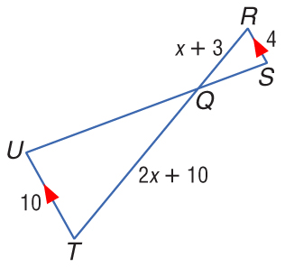
Example 4
Parts of Similar Triangles
ALGEBRA Given , RS = 4, RQ = x + 3, QT = 2x + 10, UT = 10, find RQ and QT.

Slide 17
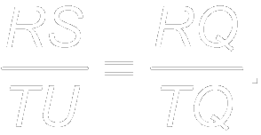
Example 4
Parts of Similar Triangles
Since because they are alternate interior angles. By AA Similarity, ΔRSQ ~ ΔTUQ. Using the definition of similar polygons,
Substitution
Cross Products Property

Slide 18
Example 4
Parts of Similar Triangles
Distributive Property
Subtract 8x and 30 from each side.
Divide each side by 2.
Now find RQ and QT.
Answer: RQ = 8; QT = 20

Slide 19
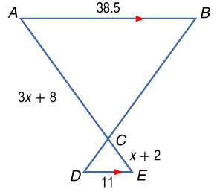
Example 4
ALGEBRA Given AB = 38.5, DE = 11, AC = 3x + 8, and CE = x + 2, find AC.
A. 2
B. 4
C. 12
D. 14
A
B
C
D

Slide 20
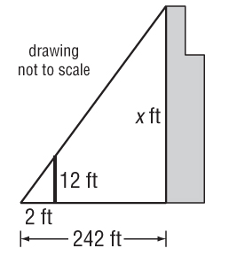
Example 5
Indirect Measurement
SKYSCRAPERS Josh wanted to measure the height of the Sears Tower in Chicago. He used a 12-foot light pole and measured its shadow at 1 p.m. The length of the shadow was 2 feet. Then he measured the length of Sears Tower’s shadow and it was 242 feet at the same time. What is the height of the Sears Tower?
Understand Make a sketch of the situation.

Slide 21
Example 5
Indirect Measurement
Plan In shadow problems, you can assume that the angles formed by the Sun’s rays with any two objects are congruent and that the two objects form the sides of two right triangles. Since two pairs of angles are congruent, the right triangles are similar by the AA Similarity Postulate.
So the following proportion can be written.

Slide 22
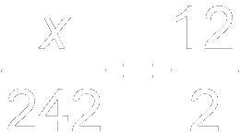
Example 5
Indirect Measurement
Solve Substitute the known values and let x be the height of the Sears Tower.
Substitution
Cross Products Property
Simplify.
Divide each side by 2.

Slide 23
Example 5
Indirect Measurement
Answer: The Sears Tower is 1452 feet tall.
242
Check The shadow length of the Sears Tower is or 121 times the shadow length of the light pole. Check to see that the height of the Sears Tower is 121 times the height of the light pole. = 121 
______
2
1452
______
12

Slide 24
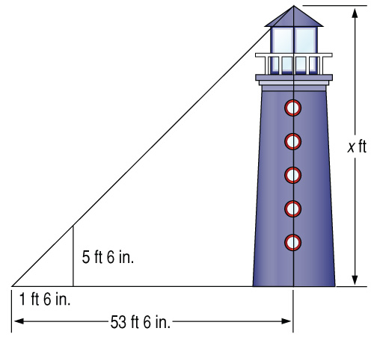
Example 5
LIGHTHOUSES On her trip along the East coast, Jennie stops to look at the tallest lighthouse in the U.S. located at Cape Hatteras, North Carolina. At that particular time of day, Jennie measures her shadow to be 1 foot 6 inches in length and the length of the shadow of the lighthouse to be 53 feet 6 inches. Jennie knows that her height is 5 feet 6 inches. What is the height of the Cape Hatteras lighthouse to the nearest foot?
A
B
C
D
A. 196 ft B. 39 ft
C. 441 ft D. 89 ft

Slide 25
Concept

Slide 26
End of the Lesson

