Slide 1
Splash Screen

Slide 2
Then/Now
You used proportions to solve problems between similar triangles. (Lesson 7–3)
Use proportional parts within triangles.
Use proportional parts with parallel lines.

Slide 3
Vocabulary
midsegment of a triangle

Slide 4
Concept

Slide 5
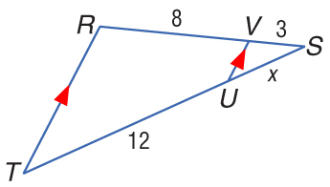
Example 1
Find the Length of a Side

Slide 6
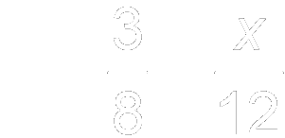
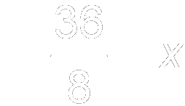
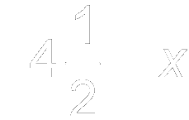
Example 1
Find the Length of a Side
Substitute the known measures.
Cross Products Property
Multiply.
Divide each side by 8.
Simplify.

Slide 7
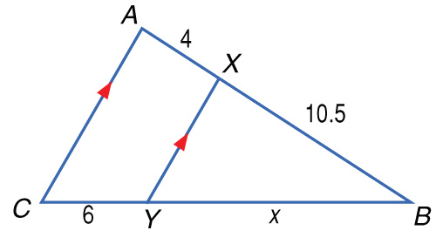
Example 1
A. 2.29
B. 4.125
C. 12
D. 15.75
A
B
C
D

Slide 8
Concept

Slide 9
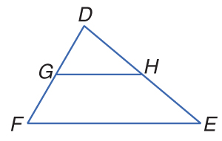
Example 2
Determine if Lines are Parallel
In order to show that we must show that

Slide 10
Example 2
Determine if Lines are Parallel
Since the sides are proportional.
Answer: Since the segments have proportional lengths, GH || FE.

Slide 11
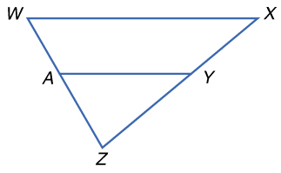
Example 2
A. yes
B. no
C. cannot be determined
A
B
C

Slide 12
Concept

Slide 13
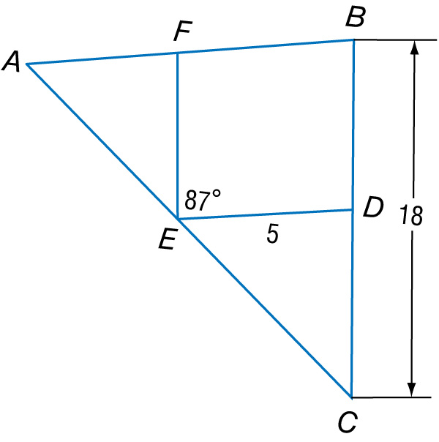
Example 3
Use the Triangle Midsegment Theorem
A. In the figure, DE and EF are midsegments of ΔABC. Find AB.

Slide 14
Example 3
Use the Triangle Midsegment Theorem
ED = AB Triangle Midsegment Theorem
1
__
2
5 = AB Substitution
1
__
2
10 = AB Multiply each side by 2.
Answer: AB = 10

Slide 15
Example 3
Use the Triangle Midsegment Theorem
B. In the figure, DE and EF are midsegments of ΔABC. Find FE.

Slide 16
Example 3
Use the Triangle Midsegment Theorem
FE = BC Triangle Midsegment Theorem
1
__
2
FE = (18) Substitution
1
__
2
FE = 9 Simplify.
Answer: FE = 9

Slide 17
Example 3
Use the Triangle Midsegment Theorem
C. In the figure, DE and EF are midsegments of ΔABC. Find m∠AFE.

Slide 18
Example 3
Use the Triangle Midsegment Theorem
By the Triangle Midsegment Theorem, AB || ED.
∠AFE ≅ ∠FED Alternate Interior Angles Theorem
m∠AFE = m∠FED Definition of congruence
m∠AFE = 87 Substitution
Answer: m∠AFE = 87

Slide 19
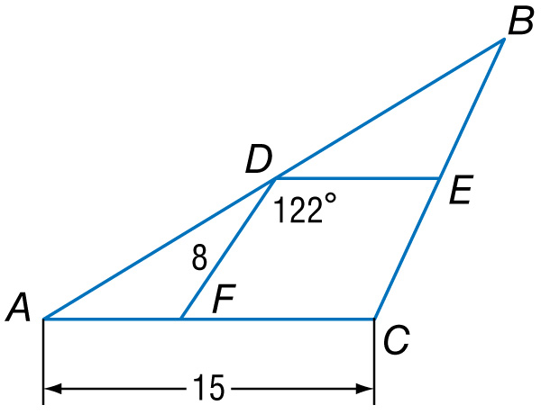
Example 3
A. In the figure, DE and DF are midsegments of ΔABC. Find BC.
A. 8
B. 15
C. 16
D. 30
A
B
C
D

Slide 20
Example 3
B. In the figure, DE and DF are midsegments of ΔABC. Find DE.
A. 7.5
B. 8
C. 15
D. 16
A
B
C
D

Slide 21
Example 3
C. In the figure, DE and DF are midsegments of ΔABC. Find m∠AFD.
A. 48
B. 58
C. 110
D. 122
A
B
C
D

Slide 22
Concept

Slide 23
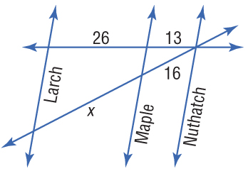
Example 4
Use Proportional Segments of Transversals
MAPS In the figure, Larch, Maple, and Nuthatch Streets are all parallel. The figure shows the distances in between city blocks. Find x.

Slide 24
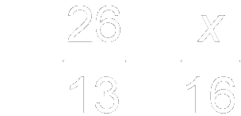
Example 4
Use Proportional Segments of Transversals
Notice that the streets form a triangle that is cut by parallel lines. So you can use the Triangle Proportionality Theorem.
Triangle Proportionality Theorem
Cross Products Property
Multiply.
Divide each side by 13.
Answer: x = 32

Slide 25
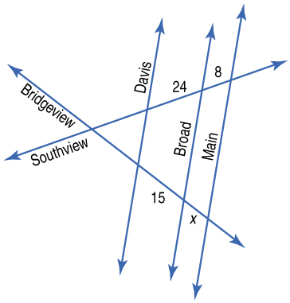
Example 4
In the figure, Davis, Broad, and Main Streets are all parallel. The figure shows the distances in between city blocks. Find x.
A. 4
B. 5
C. 6
D. 7
A
B
C
D

Slide 26
Concept

Slide 27
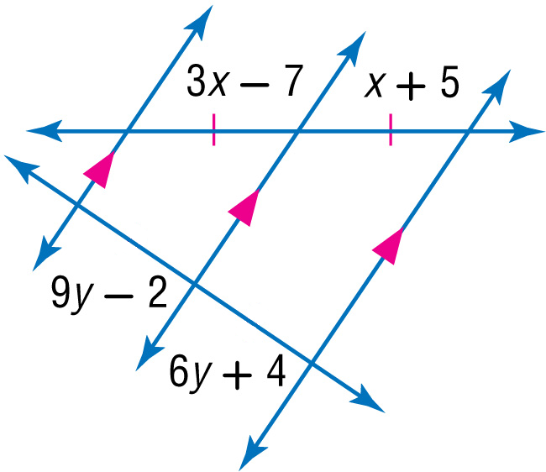
Example 5
Use Congruent Segments of Transversals
ALGEBRA Find x and y.
To find x:
3x – 7 = x + 5 Given
2x – 7 = 5 Subtract x from each side.
2x = 12 Add 7 to each side.
x = 6 Divide each side by 2.

Slide 28
Example 5
Use Congruent Segments of Transversals
To find y:
The segments with lengths 9y – 2 and 6y + 4 are congruent since parallel lines that cut off congruent segments on one transversal cut off congruent segments on every transversal.

Slide 29
Example 5
Use Congruent Segments of Transversals
9y – 2 = 6y + 4 Definition of congruence
3y – 2 = 4 Subtract 6y from each side.
3y = 6 Add 2 to each side.
y = 2 Divide each side by 3.
Answer: x = 6; y = 2

Slide 30
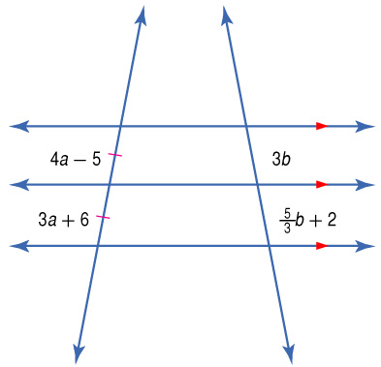
Example 5
Find a and b.
2
__
A. ;
B. 1; 2
C. 11;
D. 7; 3
3
A
B
C
D
3
__
2

Slide 31
End of the Lesson

