Slide 1
Splash Screen

Slide 2
Then/Now
You used proportional relationships of corresponding angle bisectors, altitudes, and medians of similar triangles. (Lesson 7–5)
Find the geometric mean between two numbers.
Solve problems involving relationships between parts of a right triangle and the altitude to its hypotenuse.

Slide 3
Vocabulary
geometric mean

Slide 4
Concept

Slide 5
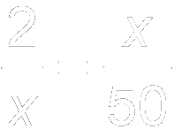
Example 1
Geometric Mean
Find the geometric mean between 2 and 50.
Let x represent the geometric mean.
Definition of geometric mean
Cross products
Take the positive square root of each side.
Simplify.
Answer: The geometric mean is 10.

Slide 6
Example 1
A. Find the geometric mean between 3 and 12.
A. 3.9
B. 6
C. 7.5
D. 4.5
A
B
C
D

Slide 7
Concept

Slide 8
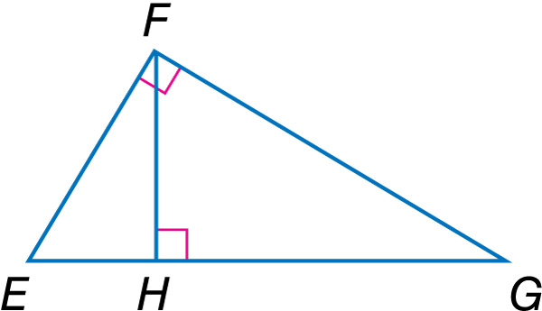
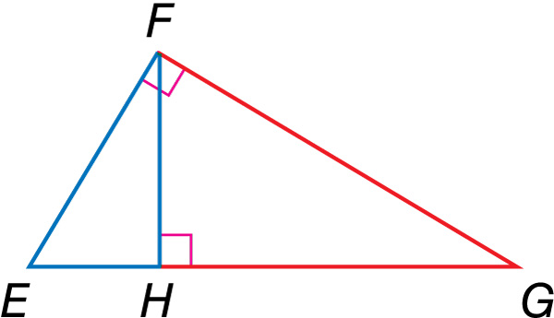
Example 2
Identify Similar Right Triangles
Write a similarity statement identifying the three similar triangles in the figure.
Separate the triangles into two triangles along the altitude.

Slide 9
Example 2
Identify Similar Right Triangles
Then sketch the three triangles, reorienting the smaller ones so that their corresponding angles and sides are in the same position as the original triangle.
Answer: So, by Theorem 8.1, ΔEGF ~ ΔFGH ~ ΔEFH.

Slide 10
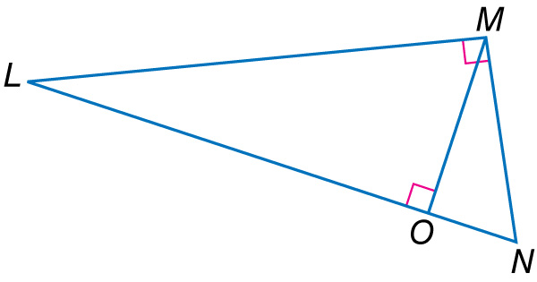
Example 2
Write a similarity statement identifying the three similar triangles in the figure.
A. ΔLNM ~ ΔMLO ~ ΔNMO
B. ΔNML ~ ΔLOM ~ ΔMNO
C. ΔLMN ~ ΔLOM ~ ΔMON
D. ΔLMN ~ ΔLMO ~ ΔMNO
A
B
C
D

Slide 11
Concept

Slide 12
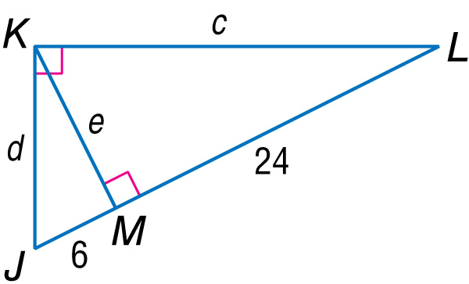
Example 3
Use Geometric Mean with Right Triangles
Find c, d, and e.

Slide 13
Example 3
Use Geometric Mean with Right Triangles
Since e is the measure of the altitude drawn to the hypotenuse of right ΔJKL, e is the geometric mean of the lengths of the two segments that make up the hypotenuse, JM and ML.
Geometric Mean (Altitude) Theorem
Substitution
Simplify.

Slide 14
Example 3
Use Geometric Mean with Right Triangles
Since d is the measure of leg JK, d is the geometric mean of JM, the measure of the segment adjacent to this leg, and the measure of the hypotenuse JL.
Geometric Mean (Leg) Theorem
Substitution
Use a calculator to simplify.

Slide 15
Example 3
Use Geometric Mean with Right Triangles
Since c is the measure of leg KL, c is the geometric mean of ML, the measure of the segment adjacent to KL, and the measure of the hypotenuse JL.
Geometric Mean (Leg) Theorem
Substitution
Use a calculator to simplify.
Answer: e = 12, d ≈ 13.4, c ≈ 26.8

Slide 16
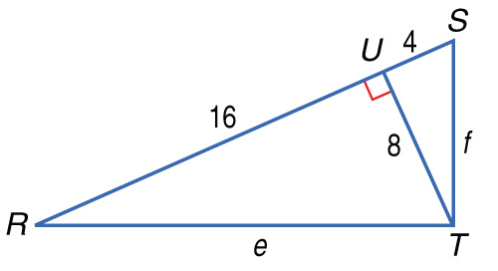
Example 3
Find e to the nearest tenth.
A. 13.9
B. 24
C. 17.9
D. 11.3
A
B
C
D

Slide 17
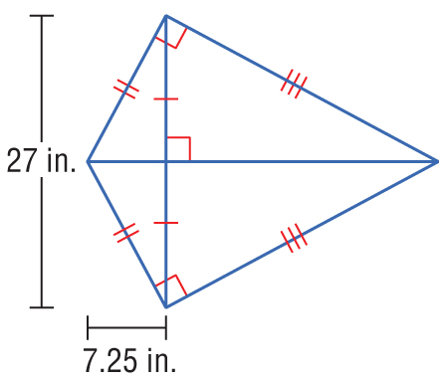
Example 4
Indirect Measurement
KITES Ms. Alspach is constructing a kite for her son. She has to arrange two support rods so that they are perpendicular. The shorter rod is 27 inches long. If she has to place the short rod 7.25 inches from one end of the long rod in order to form two right triangles with the kite fabric, what is the length of the long rod?

Slide 18
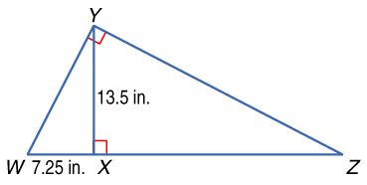
Example 4
Indirect Measurement
Draw a diagram of one of the right triangles formed.
Let be the altitude drawn from the right angle of ΔWYZ.

Slide 19
Example 4
Indirect Measurement
Geometric Mean (Altitude) Theorem
Substitution
Square each side.
Divide each side by 7.25.
Answer: The length of the long rod is 7.25 + 25.14, or about 32.39 inches long.

Slide 20
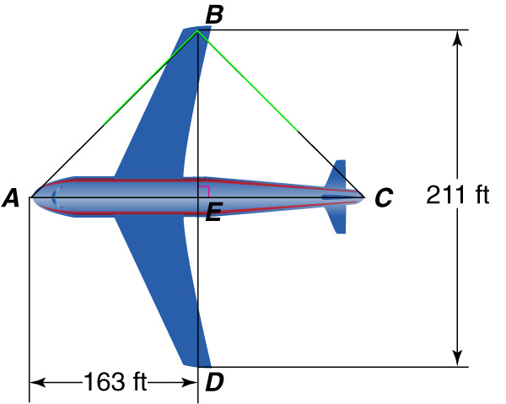
Example 4
AIRPLANES A jetliner has a wingspan, BD, of 211 feet. The segment drawn from the front of the plane to the tail, at point E. If AE is 163 feet, what is the length of the aircraft to the nearest tenth of a foot?
A. 68.3 ft
B. 231.3 ft
C. 273.1 ft
D. 436.1 ft
A
B
C
D

Slide 21
End of the Lesson

