Slide 1
Splash Screen

Slide 2
Then/Now
You used the Pythagorean Theorem to develop the Distance Formula. (Lesson 1–3)
Use the Pythagorean Theorem.
Use the Converse of the Pythagorean Theorem.

Slide 3
Vocabulary
Pythagorean triple

Slide 4
Concept

Slide 5
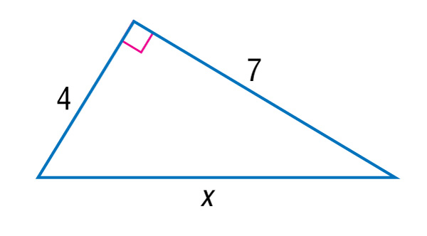
Example 1
Find Missing Measures Using the Pythagorean Theorem
A. Find x.
The side opposite the right angle is the hypotenuse, so c = x.
a² + b² = c² Pythagorean Theorem
4² + 7² = c² a = 4 and b = 7

Slide 6
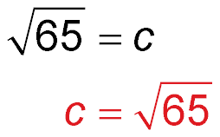
Example 1
Find Missing Measures Using the Pythagorean Theorem
65 = c² Simplify.
Take the positive square root of each side.
Answer:

Slide 7
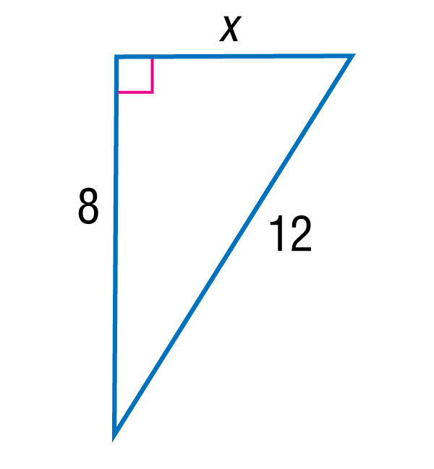
Example 1
Find Missing Measures Using the Pythagorean Theorem
B. Find x.
The hypotenuse is 12, so c = 12.
a² + b² = c² Pythagorean Theorem
x² + 8² = 12² b = 8 and c = 12

Slide 8
Example 1
Find Missing Measures Using the Pythagorean Theorem
x² + 64 = 144 Simplify.
x² = 80 Subtract 64 from each side.
Take the positive square root of each side and simplify.
Answer:

Slide 9
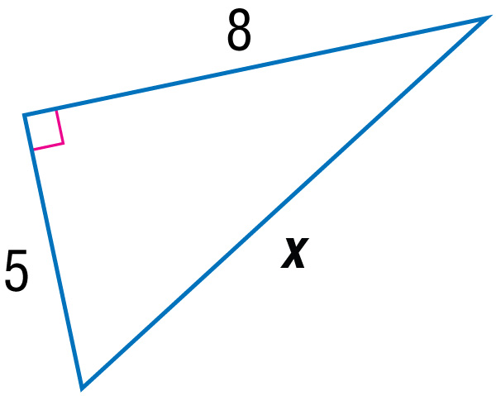
Example 1A
A. Find x.
A.
B.
C.
D.
A
B
C
D

Slide 10
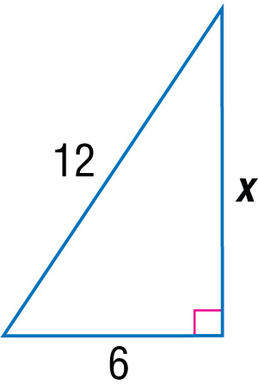
Example 1
B. Find x.
A.
B.
C.
D.
A
B
C
D

Slide 11
Concept

Slide 12
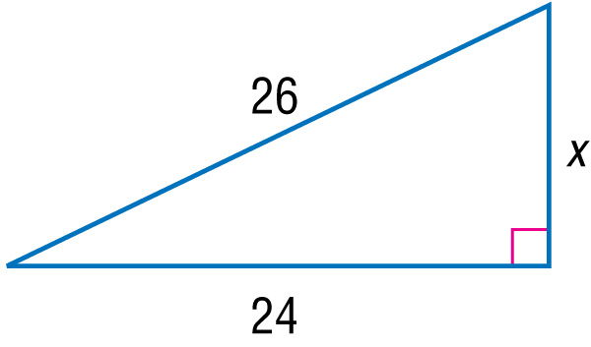
Example 2
Use a Pythagorean Triple
Use a Pythagorean triple to find x. Explain your reasoning.

Slide 13
Example 2
Use a Pythagorean Triple
Notice that 24 and 26 are multiples of 2: 24 = 2 ● 12 and 26 = 2 ● 13. Since 5, 12, 13 is a Pythagorean triple, the missing leg length x is 2 ● 5 or 10.
Answer: x = 10
?
Check: 24² + 10² = 26² Pythagorean Theorem
✓
676 = 676 Simplify.

Slide 14
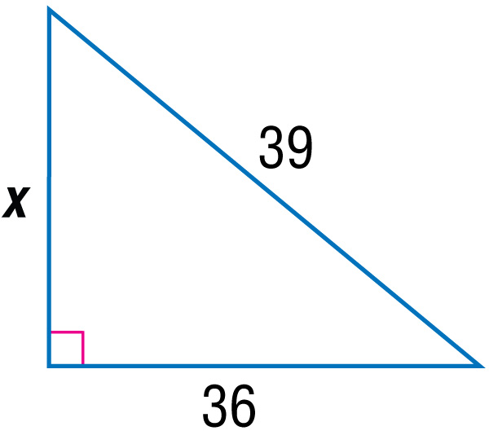
Example 2
Use a Pythagorean triple to find x.
A. 10
B. 15
C. 18
D. 24
A
B
C
D

Slide 15
Concept

Slide 16
Concept

Slide 17
Example 4
Classify Triangles
A. Determine whether 9, 12, and 15 can be the measures of the sides of a triangle. If so, classify the triangle as acute, right, or obtuse. Justify your answer.
Step 1 Determine whether the measures can form a triangle using the Triangle Inequality Theorem.
9 + 12 > 15 ✓ 9 + 15 > 12 ✓ 12 + 15 > 9 ✓
The side lengths 9, 12, and 15 can form a triangle.

Slide 18
Example 4
Classify Triangles
Step 2 Classify the triangle by comparing the square of the longest side to the sum of the squares of the other two sides.
?
c² = a² + b² Compare c² and a² + b².
?
15² = 12² + 9² Substitution
225 = 225 Simplify and compare.
Answer: Since c² = a² + b², the triangle is a right triangle.

Slide 19
Example 4
Classify Triangles
B. Determine whether 10, 11, and 13 can be the measures of the sides of a triangle. If so, classify the triangle as acute, right, or obtuse. Justify your answer.
Step 1 Determine whether the measures can form a triangle using the Triangle Inequality Theorem.
10 + 11 > 13 ✓ 10 + 13 > 11 ✓ 11 + 13 > 10 ✓
The side lengths 10, 11, and 13 can form a triangle.

Slide 20
Example 4
Classify Triangles
Step 2 Classify the triangle by comparing the square of the longest side to the sum of the squares of the other two sides.
?
c² = a² + b² Compare c² and a² + b².
?
13² = 11² + 10² Substitution
169 < 221 Simplify and compare.
Answer: Since c² < a² + b², the triangle is acute.

Slide 21
Example 4
A. Determine whether the set of numbers 7, 8, and 14 can be the measures of the sides of a triangle. If so, classify the triangle as acute, right, or obtuse. Justify your answer.
A. yes, acute
B. yes, obtuse
C. yes, right
D. not a triangle
A
B
C
D

Slide 22
Example 4
B. Determine whether the set of numbers 14, 18, and 33 can be the measures of the sides of a triangle. If so, classify the triangle as acute, right, or obtuse. Justify your answer.
A. yes, acute
B. yes, obtuse
C. yes, right
D. not a triangle
A
B
C
D

Slide 23
End of the Lesson

Slide 24
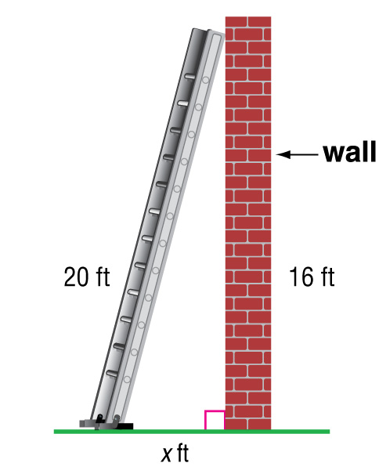
Example 3
A 20-foot ladder is placed against a building to reach a window that is 16 feet above the ground. How many feet away from the building is the bottom of the ladder?
A 3
B 4
C 12
D 15

Slide 25
Example 3
Read the Test Item
The distance the ladder is from the house, the height the ladder reaches, and the length of the ladder itself make up the lengths of the sides of a right triangle. You need to find the distance the ladder is from the house, which is a leg of the triangle.
Solve the Test Item
Method 1 Use a Pythagorean triple.
The length of a leg and the hypotenuse are 16 and 20, respectively. Notice that 16 = 4 ● 4 and 20 = 4 ● 5. Since 3, 4, 5 is a Pythagorean triple, the missing length is 4 ● 3 or 12. The answer is C.

Slide 26
Example 3
Method 2 Use the Pythagorean Theorem.
Let the distance the ladder is from the house be x.
x² + 16² = 20² Pythagorean Theorem
x² + 256 = 400 Simplify.
x² = 144 Subtract 256 from each side.
x = 12 Take the positive square root of each side.
Answer: The answer is C.

Slide 27
Example 3
A 10-foot ladder is placed against a building. The base of the ladder is 6 feet from the building. How high does the ladder reach on the building?
A. 6 ft
B. 8 ft
C. 9 ft
D. 10 ft
A
B
C
D

