Slide 1
Splash Screen

Slide 2
Key Concept 1

Slide 3
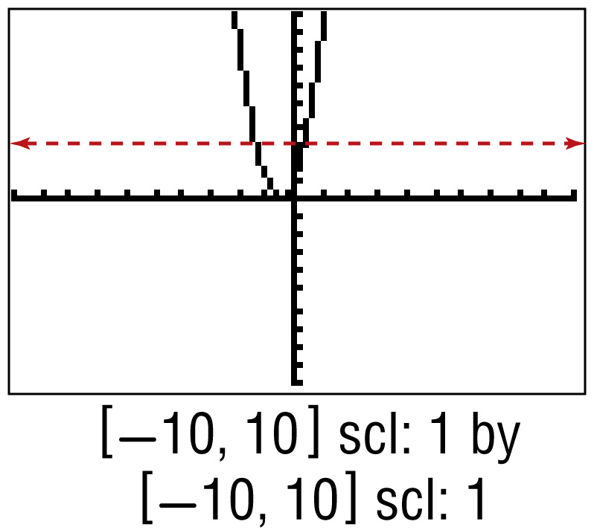
Example 1
Apply the Horizontal Line Test
A. Graph the function f (x) = 4x ² + 4x + 1 using a graphing calculator, and apply the horizontal line test to determine whether its inverse function exists. Write yes or no.
The graph of f (x) = 4x ² + 4x + 1 shows that it is possible to find a horizontal line that intersects the graph of f (x) more than once. Therefore, you can conclude that f ^{–1} does not exist.
Answer: no

Slide 4
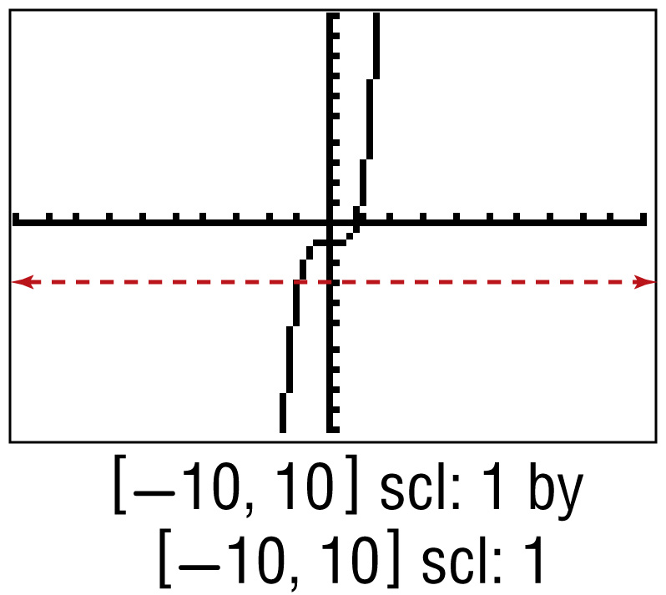
Example 1
Apply the Horizontal Line Test
B. Graph the function f (x) = x ⁵ + x ³ – 1 using a graphing calculator, and apply the horizontal line test to determine whether its inverse function exists. Write yes or no.
The graph of f (x) = x ⁵ + x ³ – 1 shows that it is not possible to find a horizontal line that intersects the graph of f (x) more than one point. Therefore, you can conclude that f ^{–1} exists.
Answer: yes

Slide 5
Key Concept 2

Slide 6
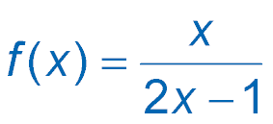
Example 2
Find Inverse Functions Algebraically
A. Determine whether f has an inverse function for
. If it does, find the inverse function and state any restrictions on its domain.
The graph of f passes the horizontal line test. Therefore, f is a one-one function and has an inverse function. From the graph, you can see that f has domain
and range . Now find f ^{–1}.
∪
∪

Slide 7
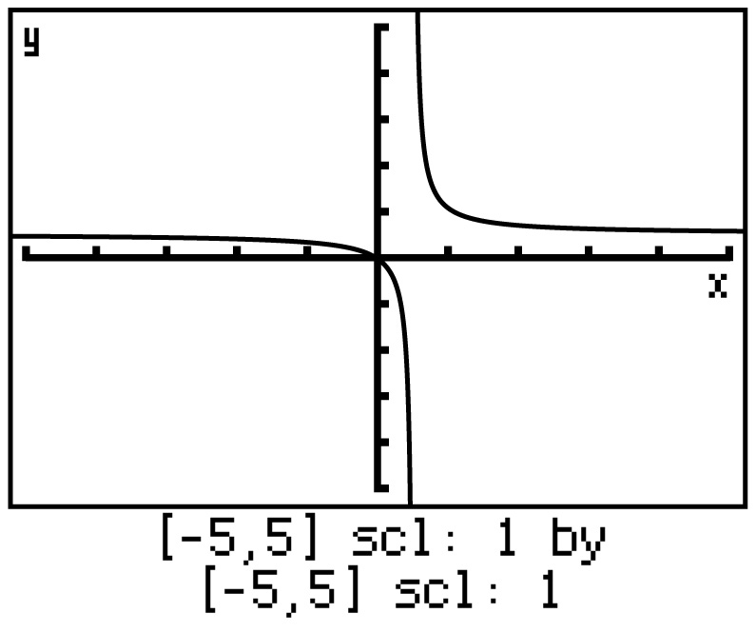
Example 2
Find Inverse Functions Algebraically

Slide 8
Example 2
Find Inverse Functions Algebraically
Original function
Replace f(x) with y.
Interchange x and y.
2xy – x = y Multiply each side by 2y – 1. Then apply the Distributive Property.
2xy – y = x Isolate the y-terms.
y(2x –1) = x Factor.

Slide 9
Example 2
Find Inverse Functions Algebraically
Divide.

Slide 10
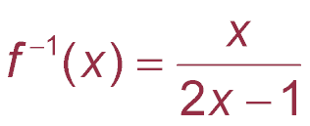
Example 2
Find Inverse Functions Algebraically
From the graph, you can see that f ^{–1} has domain and range . The domain and range of f is equal to the range and domain of f ^{–1}, respectively. Therefore, it is not necessary to restrict the domain of f ^{–1}.
∪
∪
Answer: f ^{–1} exists;

Slide 11
Key Concept 3

Slide 12
Example 3
Verify Inverse Functions
Show that f [g (x)] = x and g [f (x)] = x.

Slide 13
Example 3
Page 70 # 36a
Verify Inverse Functions
f (x) = x - 6 and g(x) = 2x + 6.
x + 2
1 - x
Show that f [g (x)] = x and g [f (x)] = x.
f[g(x)] = 2x + 6 - 6
= 2x + 6 - 6 + 6x
1 - x
Mult. for common denominator
1 - x
2x + 6 + 2
2x + 6 + 2 – 2x
1 - x
Mult. for common denominator
1 - x
Simplify and mult. By reciprical
= 8x
1 - x
( )
( )
= 8x
= x
1 - x
8
8

