Slide 1
Splash Screen

Slide 2
Then/Now
You analyzed parent functions and their families of graphs. (Lesson 1-5)
Graph and analyze power functions.
Graph and analyze radical functions, and solve radical equations.

Slide 3
Vocabulary
power function
monomial function
radical function
extraneous solution

Slide 4
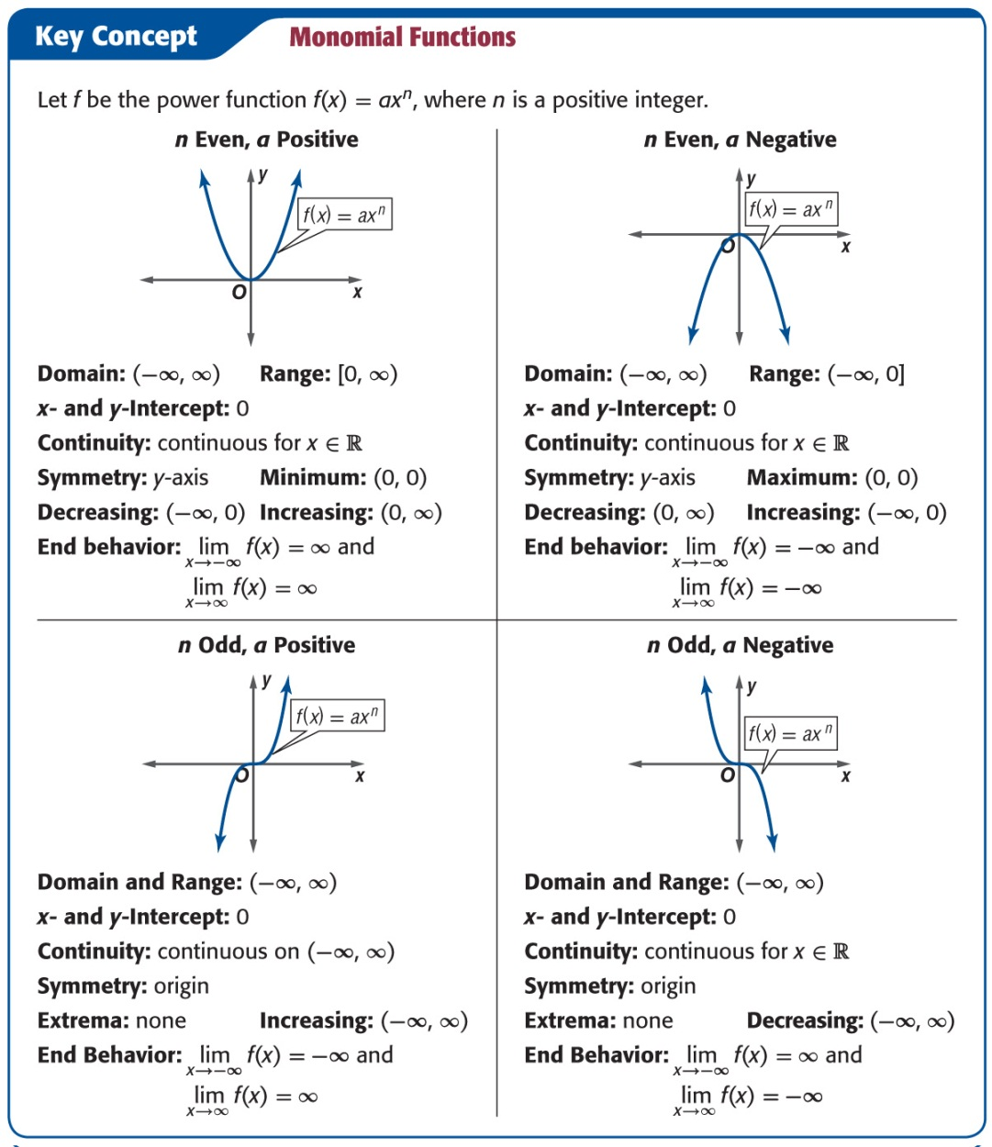
Key Concept 1

Slide 5
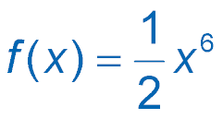
Example 1
Analyze Monomial Functions
A. Graph and analyze . Describe the domain, range, intercepts, end behavior, continuity, and where the function is increasing or decreasing.
Evaluate the function for several x-values in its domain. Then use a smooth curve to connect each of these points to complete the graph.

Slide 6
Example 1
Analyze Monomial Functions
D = (–∞, ∞); R = [0, ∞);
intercept: 0;
end behavior:
continuity: continuous for all real numbers;
decreasing: (–∞, 0); increasing: (0, ∞)

Slide 7
Example 1
Analyze Monomial Functions
Answer: D = (–∞, ∞); R = [0, ∞); intercept: 0;
continuous for all real numbers; decreasing: (–∞, 0) , increasing: (0, ∞)

Slide 8
Example 1
Analyze Monomial Functions
B. Graph and analyze f (x) = –x ⁵. Describe the domain, range, intercepts, end behavior, continuity, and where the function is increasing or decreasing.

Slide 9
Example 1
Analyze Monomial Functions
D = (–∞, ∞); R = (–∞, ∞);
intercept: 0;
end behavior:
continuity: continuous for all real numbers;
decreasing: (–∞, ∞)

Slide 10
Example 1
Analyze Monomial Functions
Answer: D = (–∞, ∞); R = (–∞, ∞); intercept: 0; continuous for all real numbers; decreasing: (–∞, 0)

Slide 11
Example 2
Functions with Negative Exponents
A. Graph and analyze f (x) = 2x ^{– 4}. Describe the domain, range, intercepts, end behavior, continuity, and where the function is increasing or decreasing.

Slide 12
Example 2
Functions with Negative Exponents
intercept: none;
end behavior:
continuity: infinite discontinuity at x = 0;
increasing: (–∞, 0); decreasing: (0, ∞)

Slide 13
Example 2
Functions with Negative Exponents
Answer: D = (– ∞, 0) ∪ (0, ∞); R = (0, ∞);
;
infinite discontinuity at x = 0; increasing: (–∞, 0), decreasing: (0, ∞);

Slide 14
Example 2
Functions with Negative Exponents
B. Graph and analyze f (x) = 2x ^{–3}. Describe the domain, range, intercepts, end behavior, continuity, and where the function is increasing or decreasing.

Slide 15
Example 2
Functions with Negative Exponents
D = (–∞, 0) ∪ (0, ∞); R = (–∞, 0) ∪ (0, ∞);
intercept: none;
end behavior:
continuity: infinite discontinuity at x = 0;
decreasing: (–∞, 0) and (0, ∞)

Slide 16
Example 2
Functions with Negative Exponents
Answer: D = (–∞, 0) ∪ (0, ∞); R = (–∞, 0) ∪ (0, ∞);
; infinite discontinuity at x = 0; decreasing: (–∞, 0) and (0, ∞)

Slide 17
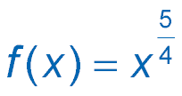
Example 3
Rational Exponents
A. Graph and analyze . Describe the domain, range, intercepts, end behavior, continuity, and where the function is increasing or decreasing.

Slide 18
Example 3
Rational Exponents
D = [0, ∞); R = [0, ∞);
intercept: 0;
end behavior:
continuity: continuous on [0, ∞);
increasing: (0, ∞)

Slide 19
Example 3
Rational Exponents
Answer: D = [0, ∞); R = [0, ∞); intercept: 0; ; continuous on (0, ∞); increasing: (0, ∞)

Slide 20
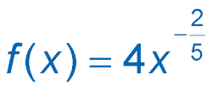
Example 3
Rational Exponents
B. Graph and analyze . Describe the domain, range, intercepts, end behavior, continuity, and where the function is increasing or decreasing.

Slide 21
Example 3
Rational Exponents
D = (–∞, 0) ∪(0, ∞); R = (0, ∞);
intercept: none;
end behavior:
continuity: infinite discontinuity at x = 0;
increasing: (–∞, 0), decreasing: (0, ∞)

Slide 22
Example 3
Rational Exponents
Answer: D = (–∞, 0) ∪(0, ∞); R = (0, ∞); ; infinite discontinuity at x = 0; increasing: (–∞, 0), decreasing: (0, ∞)

Slide 23
Key Concept 5

Slide 24
Example 5
Graph Radical Functions
A. Graph and analyze . Describe the domain, range, intercepts, end behavior, continuity, and where the function is increasing or decreasing.

Slide 25
Example 5
Graph Radical Functions
D = [0, ∞); R = [0, ∞);
intercept: 0;
continuous on [0, ∞);
increasing: (0, ∞)

Slide 26
Example 5
Graph Radical Functions
Answer: D = [0, ∞); R = [0, ∞); intercept: 0; ; continuous on [0, ∞); increasing: (0, ∞)

Slide 27
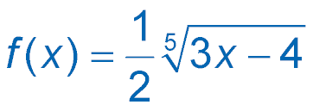
Example 5
Graph Radical Functions
B. Graph and analyze . Describe the domain, range, intercepts, end behavior, continuity, and where the function is increasing or decreasing.

Slide 28
Example 5
Graph Radical Functions
D = (–∞, ∞); R = (–∞, ∞);
x-intercept: , y-intercept: about –0.6598;
;
continuous for all real numbers;
increasing: (–∞, ∞)

Slide 29
Example 5
Graph Radical Functions
Answer: D = (–∞, ∞) ; R = (–∞, ∞) ; x-intercept: , y-intercept: about –0.6598; ; continuous for all real numbers; increasing: (–∞, ∞)

Slide 30
Example 6
Solve Radical Equations
A. Solve .
original equation
Isolate the radical.
Square each side to eliminate the radical.
Subtract 28x and 29 from each side.
Factor.
Factor.
x – 5 = 0 or x + 1 = 0
Zero Product Property
x = 5 x = –1
Solve.

Slide 31
Example 6
Solve Radical Equations
Answer: –1, 5
Check
x = 5
x = –1
10 = 10 ✓
–2 = –2 ✓
A check of the solutions in the original equation confirms that the solutions are valid.

Slide 32
Example 6
Solve Radical Equations
B. Solve .
original equation
Subtract 8 from each side.
Raise each side to the third power. (The index is 3.)
Take the square root of each side.
x = 10 or –6
Add 2 to each side.
A check of the solutions in the original equation confirms that the solutions are valid.
Answer: 10, –6

Slide 33
Example 6
Solve Radical Equations
C. Solve .
original equation
Square each side.
Isolate the radical.
Square each side.
Distributive Property
Combine like terms.
(x – 8)(x – 24) = 0
Factor.
x – 8 = 0 or x – 24 = 0
Zero Product Property

Slide 34
Example 6
Solve Radical Equations
x = 8 x = 24
Solve.
One solution checks and the other solution does not. Therefore, the solution is 8.
Answer: 8

Slide 35
End of the Lesson

