Slide 1
Splash Screen

Slide 2
Then/Now
You evaluated logarithmic expressions with different bases. (Lesson 3–2)
Apply properties of logarithms.
Apply the Change of Base Formula.

Slide 3
Key Concept 1

Slide 4
Example 1
Use the Properties of Logarithms
A. Express log 96 in terms of log 2 and log 3.
ln 96 = ln (2⁵ ● 3) 96 = 2⁵ ● 3
= ln 2⁵ + ln 3 Product Property
= 5 ln 2 + ln 3 Power Property
Answer: 5 ln 2 + ln 3

Slide 5
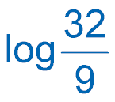
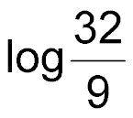
Example 1
Use the Properties of Logarithms
B. Express in terms of log 2 and log 3.
= log 32 – log 9 Quotient Property
= log 2⁵ – log3² 2⁵ = 32 and 3² = 9
= 5 log 2 – 2 log 3 Power Property
Answer: 5 log 2 – 2 log 3

Slide 6
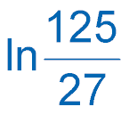
Example 1
Express ln in terms of ln 3 and ln 5.
A. 3 ln 5 + 3 ln 3
B. ln 5³ – ln 3³
C. 3 ln 5 – 3 ln 3
D. 3 ln 3 – 3 ln 5

Slide 7
Example 2
Simplify Logarithms
A. Evaluate each logarithm.
Rewrite using rational exponents.
2⁵ = 32
Power Property of Exponents
Power Property of Logarithms
log_{x} x = 1
Answer:

Slide 8
Example 2
Simplify Logarithms
B. Evaluate 3 ln e⁴ – 2 ln e².
3 ln e⁴ – 2 ln e² = 4(3 ln e) – 2(2 ln e) Power Property of Logarithms
= 12 ln e – 4 ln e Multiply.
= 12(1) – 4(1) or 8 ln e = 1
Answer: 8

Slide 9
Example 2
Evaluate .
A. 4
B.
C.
D.

Slide 10
Example 3
Expand Logarithmic Expressions
A. Expand ln 4m³n⁵.
The expression is the logarithm of the product of 4, m³, and n⁵.
ln 4m³n⁵ = ln 4 + ln m³ + ln n⁵ Product Property
= ln 4 + 3 ln m + 5 ln n Power Property
Answer: ln 4 + 3 ln m + 5 ln n

Slide 11
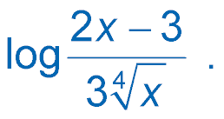
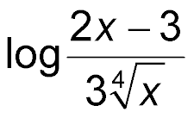
Example 3
Expand Logarithmic Expressions
B. Expand .
The expression is the logarithm of the quotient of 2x – 3 and
Quotient Property
Product Property
Rewrite using rational exponents.
Power Property

Slide 12
Example 3
Expand Logarithmic Expressions
Answer:

Slide 13
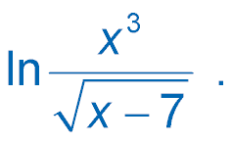
Example 3
Expand .
A. 3 ln x – ln (x – 7)
B. 3 ln x + ln (x – 7)
C. ln (x – 7) – 3 ln x
D. ln x³ – ln (x – 7)

Slide 14
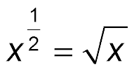
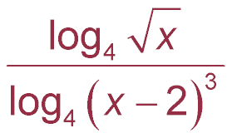
Example 4
Condense Logarithmic Expressions
A. Condense .
Power Property
Quotient Property
Answer:

Slide 15
Example 4
Condense Logarithmic Expressions
B. Condense 5 ln (x + 1) + 6 ln x.
5 ln (x + 1) + 6 ln x = ln (x + 1)⁵ + ln x⁶ Power Property
= ln x⁶(x + 1)⁵ Product Property
Answer: ln x⁶(x + 1)⁵

Slide 16
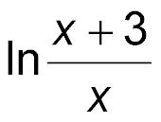
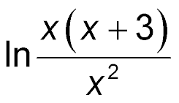
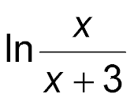
Example 4
Condense – ln x² + ln (x + 3) + ln x.
A. In x(x + 3)
B.
C.
D.

Slide 17
Key Concept 2

Slide 18
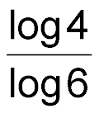
Example 5
Use the Change of Base Formula
A. Evaluate log ₆ 4.
log ₆ 4 = Change of Base Formula
≈ 0.77 Use a calculator.
Answer: 0.77

Slide 19
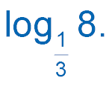
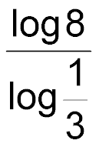
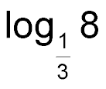
Example 5
Use the Change of Base Formula
B. Evaluate .
= Change of Base Formula
≈ –1.89 Use a calculator.
Answer: –1.89

Slide 20
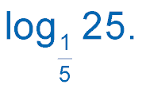
Example 5
Evaluate .
A. –2
B. –0.5
C. 0.5
D. 2

Slide 21
End of the Lesson

